Slide 1
Join Optimization of
Information Extraction Output:
Quality Matters!
Alpa Jain – Yahoo! Labs
Panagiotis G. Ipeirotis – New York University
AnHai Doan – University of Wisconsin-Madison
Luis Gravano – Columbia University

Slide 2
Information Extraction
Text documents embed valuable structured data
  Documents: e-mails, news articles, web pages,…
  Structured data: disease outbreaks, headquarters, executives,…
Information extraction uncovers structured data
BBC: May, 2006
US Airways today announced it has completed the acquisition of America West, …
Mergers
Information extraction
Company | MergedWith
US Airways | America West
US Airways
America West
AOL | Time Warner Inc.
Microsoft | Softricity
… | …

Slide 3
Joining Information Extraction Output
Real-world architectures often stitch together output from multiple extraction systems
Mergers Headquarters
Company | MergedWith | Location
US Airways | America West | Arizona
AOL | Time Warner Inc. | Virginia
Mergers
Headquarters
Company | MergedWith
US Airways | America West
AOL | Time Warner Inc.
Company | Location
US Airways | Arizona
AOL | Virginia
Information extraction
Information extraction
SeekingAlpha
Wall Street Journal
But, information extraction is a noisy process!

Slide 4
Joining Output Quality Depends on Extraction System Characteristics
Mergers Headquarters
Company | MergedWith | Location
US Airways | America West | Arizona
AOL | Time Warner Inc. | Virginia
US Airways | United Airlines | Arizona
?
Mergers
Headquarters
Company | MergedWith
US Airways | America West
AOL | Time Warner Inc.
US Airways | United Airlines
Company | Location
US Airways | Arizona
Apple | New York
AOL | Virginia
?
Information extraction
Information extraction
SeekingAlpha
Wall Street Journal
Join execution plans may differ in their output quality!

Slide 5
Designing Join Optimization Strategies
How should we configure underlying extraction systems?
How should we retrieve and process documents from database?
What join algorithms are possible?
What is the impact of individual components on overall execution characteristics?

Slide 6
Outline
Single relation extraction and output quality
Join algorithms for extracted relations
Analysis of a join execution algorithm
Join optimization strategy
Experiments and conclusion

Slide 7
Tuning Extraction Systems
Knob settings control the good and bad tuples in output
  Extraction system decides if tuple should be output based on knob setting θ
    Example: minimum similarity between patterns and candidate tuple context
Effect of knob setting can be characterized by:
  True positive rate, fraction of good tuples generated
  False positive rates, fraction of bad tuples generated
We will represent each knob setting by tp(θ), fp(θ)
Notes:
Point to [Jain and Ipeirotis, TODS 2008]

Slide 8
The Good, the Bad, and the Empty
Existence of a good or bad tuple partitions the database
  Good documents contain good tuples
  Bad documents contain no good tuples and only bad tuples
  Empty documents contain no tuples
Extraction output naturally depends on the input document composition
Extract
Good and
bad tuples
Good documents
Text database
Document retrieval strategy
Bad
documents
Extract
Bad tuples
Empty documents
Extract
No tuples
Ideally, a document retrieval strategy should retrieve no empty or bad documents

Slide 9
Choosing Document Retrieval Strategy
Text database
Issue queries
Information extraction
Document classifier
Scan: Sequentially retrieves all database documents
  Processes all good, bad, and empty documents
Filtered Scan: Uses a document classifier to decide if document is relevant
  Avoids processing all documents
  May miss some good documents
Automatic Query Generation: Uses queries to retrieve good documents
  Avoids processing all documents
  May miss some answer tuples

Slide 10
Independently Joining Extracted Relations: Independent Join
Independently extracts tuples for each relation and joins them
Uses appropriate document retrieval strategies for each relation
Mergers Headquarters
Company | MergedWith | Location
US Airways | America West | Arizona
US Airways | United Airlines | Arizona
Mergers
Headquarters
Company | MergedWith
US Airways | America West
AOL | Time Warner Inc.
US Airways | United Airlines
Company | Location
US Airways | Arizona
Apple | New York
AOL | Virginia
?
Information extraction
Information extraction
Document retrieval
Document retrieval
SeekingAlpha
Wall Street Journal

Slide 11
Adapting Index Nested-Loops : Outer/Inner Join
Resembles “index nested-loops” execution from RDBMS
Uses extracted tuples from “outer” relation to retrieve documents for “inner” relation
Mergers
Headquarters
Company | MergedWith
US Airways | America West
AOL | Time Warner Inc.
IBM | News Corp.
Company | Location
US Airways | Arizona
AOL | Virginia
IBM | Armonk
Information extraction
Inner relation
Information extraction
Information extraction
SeekingAlpha
Outer relation

Slide 12
Interleaving Extraction Process:
Zig-Zag Join
Alternates role of outer and inner relations in a nested-loop join
Uses tuples from one relation to generate queries and retrieve documents for other relation
US Airways
AOL
Issue query
Extract tuples
Issue query
Issue query
US Airways
Merck
Extract tuples
Issue query
Extract tuples
IBM
AOL
Issue query
Mergers
Headquarters

Slide 13
Understanding Join Output Quality
Output quality depends on:
  Information extraction knob setting θ
  Document retrieval strategy
  Join execution algorithm
Base relations
In join output:
  Good tuples are result of joining only good tuples from base relations
  All other tuples are bad tuples
What is the fastest execution plan to generate τ_{g} good and at most τ_{b} bad tuples in output?
Company | MergedWith | Location
US Airways | America West | Arizona
US Airways | United Airlines | Redmond
Mergers
Headquarters
Company | MergedWith
US Airways | America West
US Airways | United Airlines
Company | Location
US Airways | Redmond

Slide 14
Analyzing Join Quality: General Scheme
A – common join attribute in R₁ and R₂
a – an attribute value for A
g₁(a) – frequency of a in D₁
g₂(a) – frequency of a in D₂
gr₁(a) – number of times we observe a after processing Dr₁
gr₂(a) – number of times we observe a after processing Dr₂
Expected join tuples with A = a is gr₁(a) . gr₂(a)
How many times will be observe attribute value a after processing Dr₁ and Dr₂ documents?

Slide 15
Join Cardinality Depends on Attribute Value Occurrences: Example
US Airways occurs in 50 tuples
US Airways occurs in 10 tuples
D₁
D₂
Dr₂
Dr₁
Information extraction
Information extraction
Company | MergedWith
US Airways | America West
US Airways | Symantec
US Airways | United Airlines
1 good occurrence
Rest of the talk
|Good tuples| = 1
|Bad tuples| = 5 (2x1 + 2x1 + 1x1)
1 good occurrence
2 bad occurrences
Notes:
Mention the IE as well when discussing factors that decide the output quality.

Slide 16
Estimating Good Attribute Value Occurrences: Scan
D – database
Dg – good documents in D
E<θ> – knob setting for E described by tp(θ) and fp(θ)
X – document retrieval strategy
g(a) – frequency in Dg
We retrieve Dr documents from D using X
What is the probability of observing it k times after processing Dr?
We can derive a only from good documents Dgr among Dr
  Model document retrieval as sampling without replacement over Dg
After we extract a from Dgr, E outputs it with probability tp(θ)
  Expected frequency follows a binomial distribution
Analysis for Filtered Scan depends on classifier characteristics
Analysis for PromD depends on query characteristics
?
?
In practice, we do not know the frequency for each tuple (more on this later)

Slide 17
Outer/Inner Join Analysis
Outer relation analysis follows from single relation analysis
Inner relation analysis
  Number of queries issued using values from outer relation
  Characteristics of queries
  Number of documents returned by search interface
  Number of useful documents retrieved via direct queries or via other queries as tuples are collocated
See paper for details

Slide 18
Zig-Zag Join Analysis
Examine important properties of a zig-zag graph for a join execution using theory of random graphs [Newman, et al. 2001]
  What is the probability that a randomly chosen document contains k attributes?
  What is the probability that a randomly attribute matches k documents?
  What is the frequency of an attribute or a document chosen by following a random edge?
See paper for details

Slide 19
Estimating Parameters Using our Analysis and MLE
In practice, database-specific parameters are unknown
  Frequency of each attribute value
    Follows a power-law distribution
      Distribution parameter is yet unknown
  Number of good, bad, and empty documents
  Total number of good, and bad join tuples
  …
Our approach
  Observe output and estimate parameter values most likely to generate this output
We can estimate values on-the-fly!

Slide 20
Putting It All Together: Join Optimization
Given quality requirements of τ_{g} good and τ_{b} bad tuples:
  Pick an initial join execution strategy
  Run initial execution strategy
  Use observed output to estimate database-specific model parameters
  Use analysis to estimate output quality and execution time of candidate execution strategies
  Pick an execution strategy, if desirable

Slide 21
Experimental Evaluation
Large news archives: New York Times 1995, New York Times 1996, Wall Street Journal
Extraction systems: Snowball [Agichtein and Gravano, DL 2000]
Extracted relations: Headquarters, Executives, and Mergers
Document retrieval strategies: Scan, Filtered scan, and Automated query generation

Slide 22
Accuracy of our Analytical Models: Independent Join
We verified our analytical models
  Assume complete knowledge of all parameters and estimate the number of good and bad join tuples in the output for different documents retrieved
In general, our estimated values are close to the actual values

Slide 23
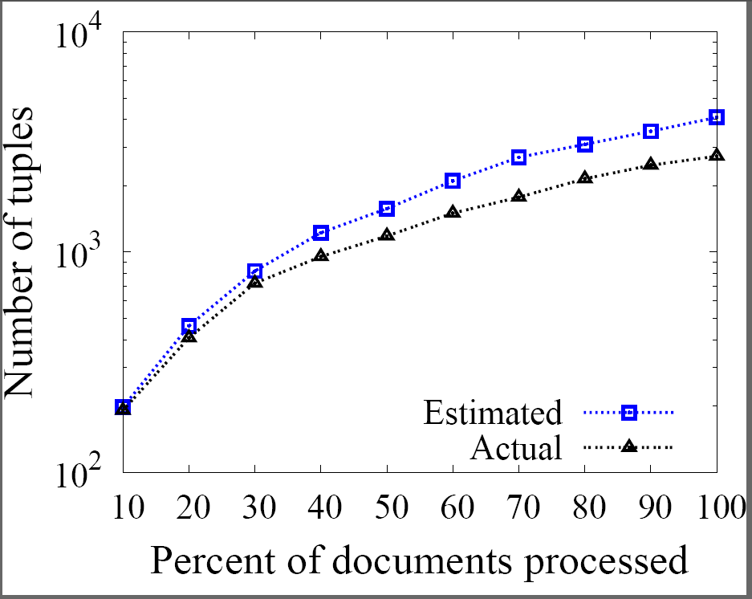
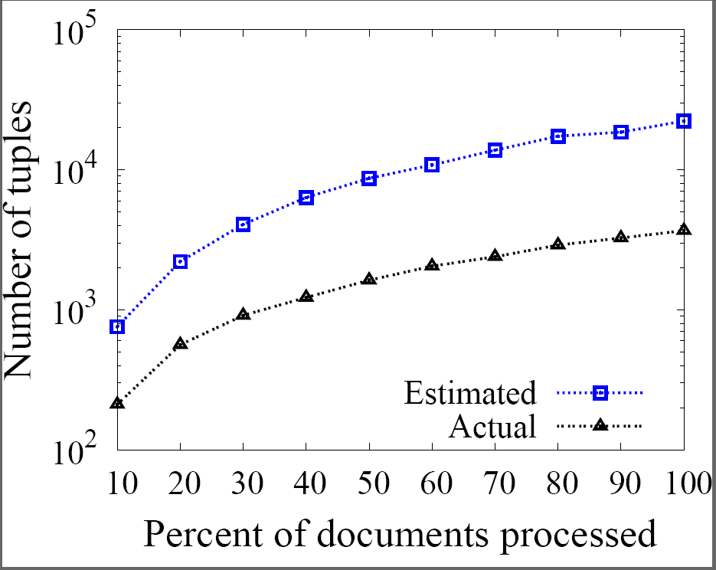
Accuracy of our Analytical Models: Outer/Inner Join
Overestimation due to outlier cases
Number of good tuples
Number of bad tuples
We examined expected attribute frequencies with actual attribute frequencies
  Some attributes show unexpected behavior
In general, our estimated values are close to the actual values
Notes:
Discuss overestimation error and prominence in case of ZIG-ZAG

Slide 24
Summary of Experimental Evaluation
Analysis correctly captures output quality of join execution strategies
  Estimation error is mostly zero, or follows a Gaussian with mean at zero
  Zig-Zag join can reach a large fraction of tuples determined by reachability study
Our optimizer picks desirable execution plans for various output quality requirements

Slide 25
Processing Joins over Extracted Relations: Contributions
Proposed three join algorithms for extracted relations
Rigorously analyzed three different join algorithms in terms of their execution efficiency and output quality
Derived closed-form solutions for execution time and output quality of a join execution
An end-to-end join optimization strategy

Slide 26
Related Work
Building information extraction systems
  Unsupervised or learning-based techniques [Agichtein and Gravano 2000; Brin, 1998; Etzioni et al., 2004; Riloff 1993, etc.]
  Exploit legacy data from RDBMS [Mansuri and Sarawagi, 2006]
Join optimization [GATE, UIMA, Xlog, etc.]
  Declarative programs for combining extraction output
  Analyze execution time
Other extraction-related scenarios
  Extraction over dynamic data [Chen et al., 2008; ]
  Schema discovery [Cafarella et al., 2007]
  Probabilistic database for processing queries [Gupta and Sarawagi, 2006, Cafarella et al., 2007]
Online query optimization approach
  Trust information extraction output and optimize over single-relation [Ipeirotis et al., 2006]
  Simple SQL queries using only one join algorithm [Jain et al., 2008]

Slide 27
Thank you!

Slide 28
Overflow

Slide 29

Analyzing Document Retrieval: Independent Join
A – common join attribute in R₁ and R₂
a – an attribute value for A
gr₁(a) – number of times we observe a after processing Dr₁
gr₂(a) – number of times we observe a after processing Dr₂
Expected join tuples with A = a is gr₁(a) . gr₂(a)
How many times will be observe attribute value a after processing Dr₁ and Dr₂ documents?
How many good documents will we observe after retrieving Dr documents?
Dg – good documents in D
Dr – retrieved documents
Dgr – good documents observed in Dr
Model document retrieval as sampling without replacement over D
Analysis for Filtered Scan depends on classifier characteristics
Analysis for PromD depends on query characteristics
Notes:
Continue here …
E[gr_{i}(a)] depends on
Attribute value frequencies
Number of good, bad, and empty documents
Knob-setting θ

