Slide 1
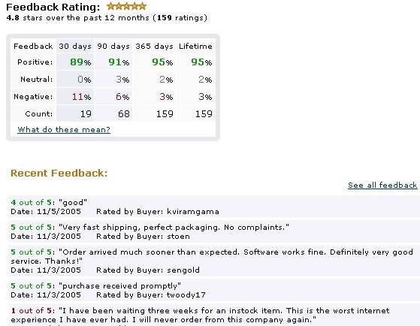
Analyzing User-Generated Content using Econometrics
Panos Ipeirotis
Stern School of Business
New York University

Slide 2
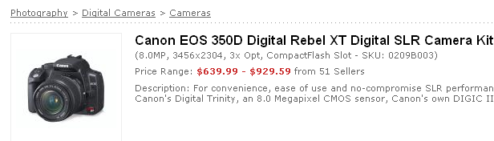
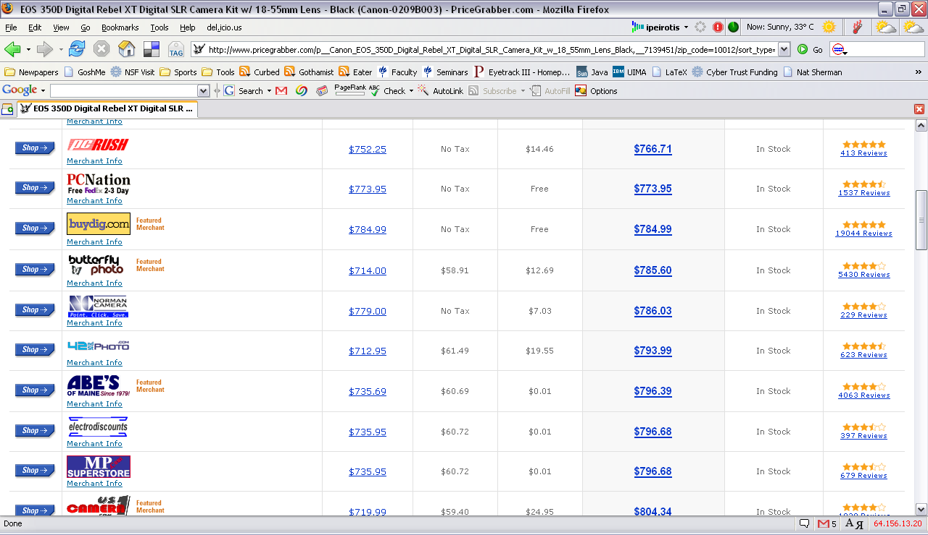
Comparative Shopping

Slide 3
Comparative Shopping

Slide 4
Are Customers Irrational?
BuyDig.com gets
Price Premium
(customers pay more than
the minimum price)
$11.04 (+1.5%)

Slide 5
Price Premiums / Discounts @ Amazon
Are Sellers Irrational (?)
(charging less)
Are Buyers Irrational (?)
(paying more)

Slide 6
Why not Buying the Cheapest?
You buy more than a product
Customers do not pay only for the product
Customers also pay for a set of fulfillment characteristics
  Delivery
  Packaging
  Responsiveness
  …
Customers care about reputation of sellers!

Slide 7
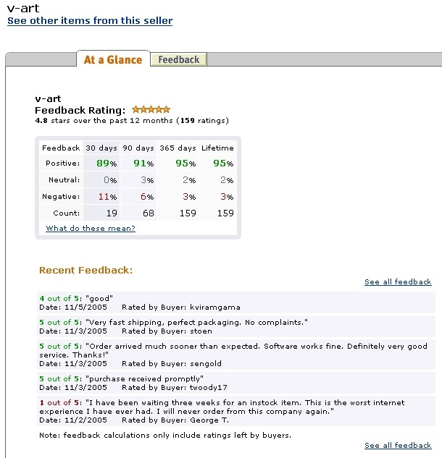
Example of a reputation profile

Slide 8
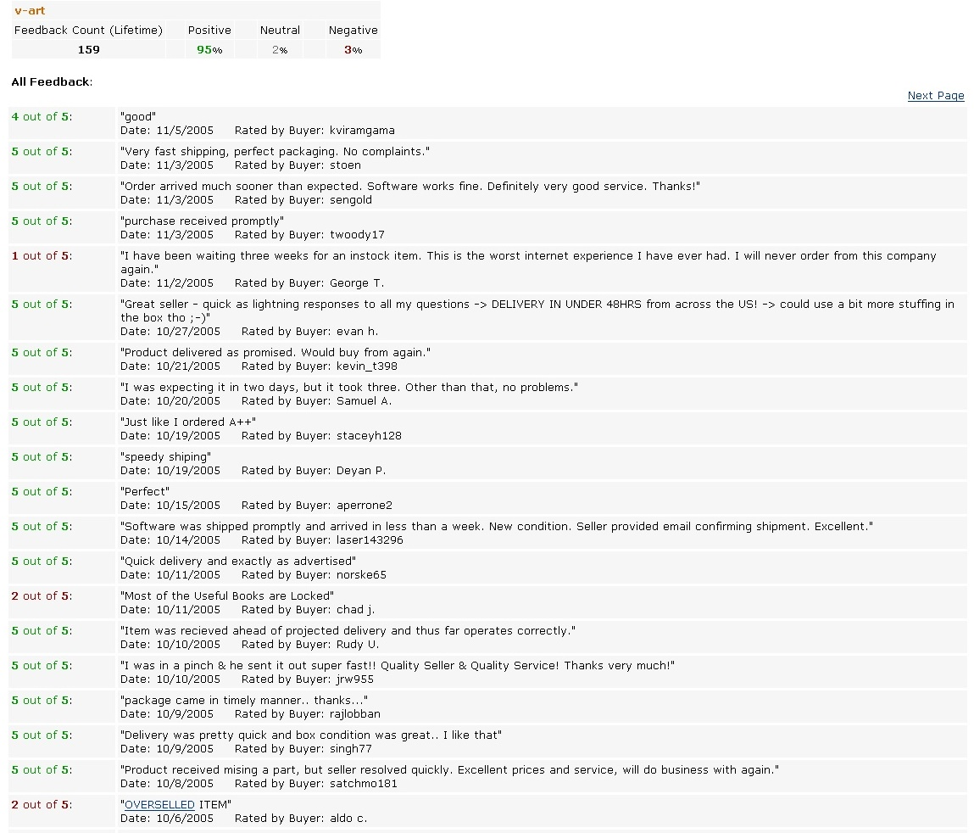

Slide 9
The Idea in a Single Slide
Conjecture:
Price premiums measure reputation
Reputation is captured in text feedback
Our contribution:
Examine how text affects price premiums
(and learn to rank opinion phrases as a side effect)
ACL 2007

Slide 10
Data: Variables of Interest
Price Premium
Difference of price charged by a seller minus listed price of a competitor
  Price Premium = (Seller Price – Competitor Price)
Calculated for each seller-competitor pair, for each transaction
Each transaction generates M observations, (M: number of competing sellers)
Alternative Definitions:
  Average Price Premium (one per transaction)
  Relative Price Premium (relative to seller price)
  Average Relative Price Premium (combination of the above)

Slide 11
Decomposing Reputation
Is reputation just a scalar metric?
Previous studies assumed a “monolithic” reputation
Decompose reputation in individual components
Sellers characterized by a set of fulfillment characteristics
(packaging, delivery, and so on)
What are these characteristics (valued by consumers?)
We think of each characteristic as a dimension, represented by a noun, noun phrase, verb or verbal phrase (“shipping”, “packaging”, “delivery”, “arrived”)
We scan the textual feedback to discover these dimensions

Slide 12
Decomposing and Scoring Reputation
Decomposing and scoring reputation
We think of each characteristic as a dimension, represented by a noun or verb phrase (“shipping”, “packaging”, “delivery”, “arrived”)
The sellers are rated on these dimensions by buyers using modifiers (adjectives or adverbs), not numerical scores
  “Fast shipping!”
  “Great packaging”
  “Awesome unresponsiveness”
  “Unbelievable delays”
  “Unbelievable price”
How can we find out the meaning of these adjectives?

Slide 13
Structuring Feedback Text: Example
What is the reputation score of this feedback?
  P1: I was impressed by the speedy delivery! Great Service!
  P2: The item arrived in awful packaging, but the delivery was speedy
Deriving reputation score
We assume that a modifier assigns a “score” to a dimension
α(μ, k): score associated when modifier μ evaluates the k-th dimension
w(k): weight of the k-th dimension
Thus, the overall (text) reputation score Π(i) is a sum:
Π(i) = 2*α (speedy, delivery) * weight(delivery)+
1*α (great, service) * weight(service) +
1*α (awful, packaging) * weight(packaging)
unknown?
unknown

Slide 14
Sentiment Scoring with Regressions
Scoring the dimensions
Use price premiums as “true” reputation score Π(i)
Use regression to assess scores (coefficients)
Π(i) = 2*α (speedy, delivery) * weight(delivery)+
1*α (great, service) * weight(service) +
1*α (awful, packaging) * weight(packaging)
Price
Premium
estimated coefficients
Regressions
Control for all variables that affect price premiums
Control for all numeric scores of reputation
Examine effect of text: E.g., seller with “fast delivery” has premium $10 over seller with “slow delivery”, everything else being equal
 “fast delivery” is $10 better than “slow delivery”

Slide 15
Measuring Reputation
Regress textual reputation against price premiums
Example for “delivery”:
  Fast delivery vs. Slow delivery: +$7.95
  So “fast” is better than “slow” by a $7.95 margin

Slide 16
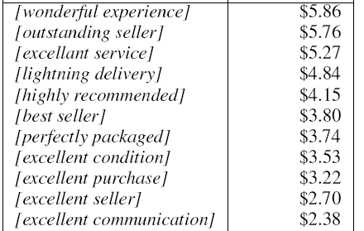
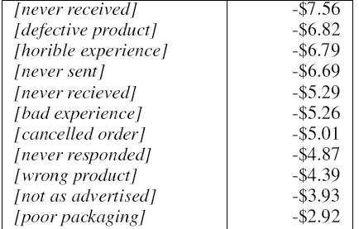
Some Indicative Dollar Values
Positive
Negative
captures misspellings as well
Natural method for extracting sentiment strength and polarity
good packaging
-$0.56
Positive?
Negative
?
Naturally captures the pragmatic meaning within the given context

Slide 17
More Results
Further evidence: Who will make the sale?
Classifier that predicts sale given set of sellers
Binary decision between seller and competitor
Used Decision Trees (for interpretability)
Training on data from Oct-Jan, Test on data from Feb-Mar
Only prices and product characteristics: 55%
+ numerical reputation (stars), lifetime: 74%
+ encoded textual information: 89%
text only: 87%
Text carries more information than the numeric metrics

Slide 18
Looking Back
Comprehensive setting
  All information about merchants stored at feedback profile
Easy text processing
  Large number of feedback postings (100’s and 1000’s of postings common)
  Short and concise language

Slide 19
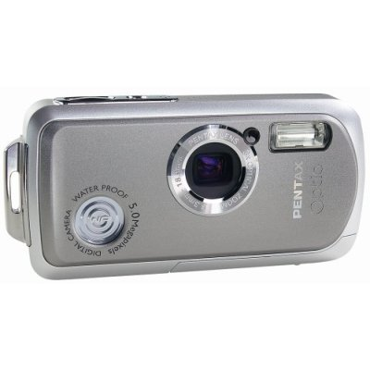
Similar Setting: Word of “Mouse”
I love virtually everything about this camera....except the lousy picture quality. The camera looks great, feels nice, is easy to use, starts up quickly, and is of course waterproof. It fits easily in a pocket and the battery lasts for a reasonably long period of time.
Consumer reviews
  Derived from user experience
  Describe different product features
  Provide subjective evaluations of product features
Product reviews affect product sales
  What is the importance of each product feature?
  What is the consumer evaluation of each feature?
Apply the same techniques?

Slide 20
Contrast with Reputation
Significant data sparseness
Smaller number of reviews per product
  Typically 30-50 reviews vs. 200-5,000 postings
Much longer than feedback postings
  2-3 paragraphs each, vs 80-100 characters in reputation
Not an isolated system
Consumers form opinions from many sources

Slide 21
Bayesian Learning Approach
Consumers perform Bayesian learning of product attributes using signals from reviews
  Consumers have prior expectations of quality
  Consumers update expectation from new signals

Slide 22
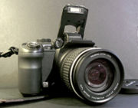
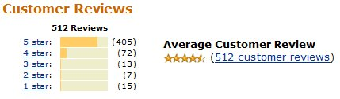
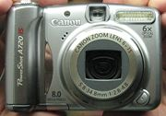
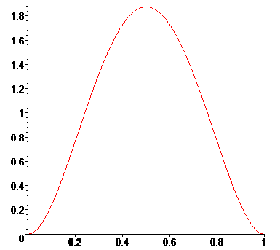
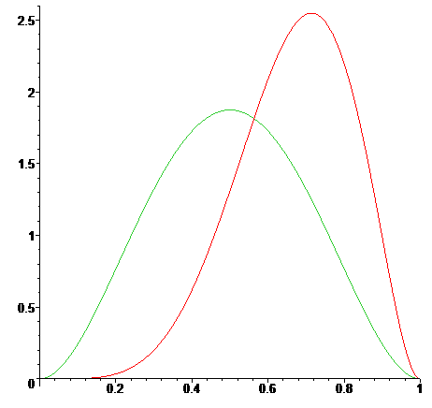
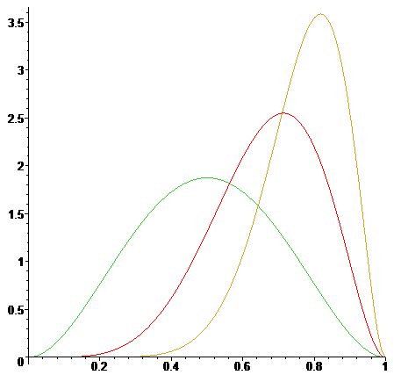
Online shopping as learning
✓
✗
“excellent image quality”
“fantastic image quality”
“superb image quality”
“great image quality”
“fantastic image quality”
“superb image quality”
Belief for Image Quality
Updated Belief for Image Quality
Updated Belief for Image Quality
Consumers pick the product that maximizes their expected utility

Slide 23
Expected Utility
Consumers pick the product that maximizes their expected utility
Expected utility based on:
  Mean of the evaluation and
  Uncertainty of the evaluation
  Notice: negative reviews may increase sales!
Mean(design)
Mean(img qual)
Var(design)
Variance(img qual)
+
U=
Design
Image Quality

Slide 24


Product Reviews and Product Sales
Examine changes in demand and infer parameters
“excellent lens”
“excellent photos”
+3%
+6%
“poor lens”
“poor photos”
-1%
-2%
Feature “photos” is two time more important than “lens”
“Excellent” is positive, “poor” is negative
“Excellent” is three times stronger than “poor”

Slide 25
Feature Weights for Digital Cameras
Point & Shoot
SLR

Slide 26
New Product Search Approach
Consumers want the “best product” first
Best product: Highest value for the money
  Maximize (gained) product utility
  Minimize (lost) utility of money

Slide 27
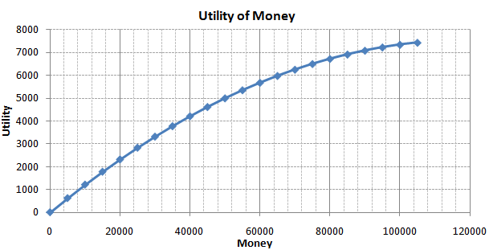
Utility of Money
The highest the available income, the lowest the utility of money
(i.e., rich people spend easier)

Slide 28
Hotel Search Application
Transaction data from big travel search website
Computed “expected utility” for each hotel using:
  Reviews
  Satellite photos for landscape (beach, downtown, highway,…)
  Location statistics (crime, etc) and points of interest
Substracted “utility of money” based on its price
Ranked according to “consumer surplus” (i.e., difference of two)

Slide 29
Hotel Ranking
Percentage of users preferring econometric ranking in blind comparison
Cities | Tripadvisor | Travelocity | Price Low to high | Price High to Low | Hotel Class | # Review | # of Amenities
New York | 72% | 68% | 62% | 70% | 66% | 66% | 62%
Los Angeles | 68% | 66% | 64% | 84% | 88% | 80% | 64%
San Francisco | 84% | 62% | 68% | 72% | 66% | 66% | 70%
Orlando | 64% | 68% | 68% | 74% | 66% | 74% | 66%
New Orleans | 84% | 62% | 83% | 64% | 64% | 66% | 70%
Salt Lake City | 80% | 80% | 68% | 72% | 82% | 66% | 68%
Significance Level |  |  | P=0.01 ≥ 66% | P=0.001 ≥ 72% | (Sign Test, N=50)

Slide 30
Other Applications
Financial news and price/variance prediction
Measuring (and predicting) importance of political events
Deriving better keyword bidding, pricing, and ad generation strategies
http://economining.stern.nyu.edu

Slide 31
Other Projects
SQoUT project
Structured Querying over Unstructured Text
http://sqout.stern.nyu.edu
Managing Noisy Labelers
Amazon Mechanical Turk, “Wisdom of the Crowds”

Slide 32
SQoUT: Structured Querying over Unstructured Text
Information extraction applications extract structured relations from unstructured text
May 19 1995, Atlanta -- The Centers for Disease Control
and Prevention, which is in the front line of the world's
response to the deadly Ebola epidemic in Zaire ,
is finding itself hard pressed to cope with the crisis…
Disease Outbreaks in The New York Times
Date | Disease Name | Location
Jan. 1995 | Malaria | Ethiopia
July 1995 | Mad Cow Disease | U.K.
Feb. 1995 | Pneumonia | U.S.
May 1995 | Ebola | Zaire
Information
Extraction System
(e.g., NYU’s Proteus)

Slide 33
SQoUT: The Questions
SIGMOD’06, TODS’07,
ICDE’09, TODS’09
Output Tokens
…
Text Databases
Extraction
System(s)
Retrieve documents from database/web/archive
Process documents
Extract output tuples
Questions:
How to we retrieve the documents?
How to configure the extraction systems?
What is the execution time?
What is the output quality?

Slide 34
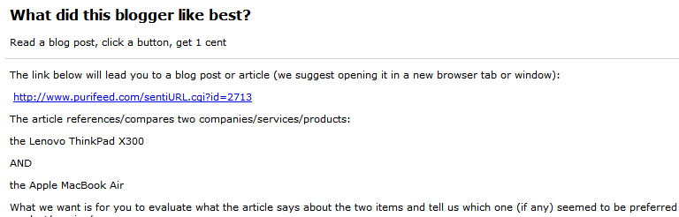


Mechanical Turk Example

Slide 35
Motivation
Labels can be used in training predictive models
  Duplicate detection systems
  Image recognition
  Web search
But: labels obtained from above sources are noisy. This directly affects the quality of learning models
  How can we know the quality of annotators?
  How can we know the correct answer?
  How can we use best noisy annotators?

Slide 36
Quality and Classification Performance
Labeling quality increases  classification quality increases
Q = 1.0
Q = 0.8
Q = 0.6
Q = 0.5

Slide 37
Tradeoffs for Classification
Get more labels  Improve label quality  Improve classification
Get more examples  Improve classification
Q = 1.0
Q = 0.8
Q = 0.6
Q = 0.5
KDD 2008

Slide 38
Thank you! Questions?

Slide 39
Price premiums @ Amazon

Slide 40
Average price premiums @ Amazon

Slide 41
Relative Price Premiums

Slide 42
Average Relative Price Premiums

Slide 43
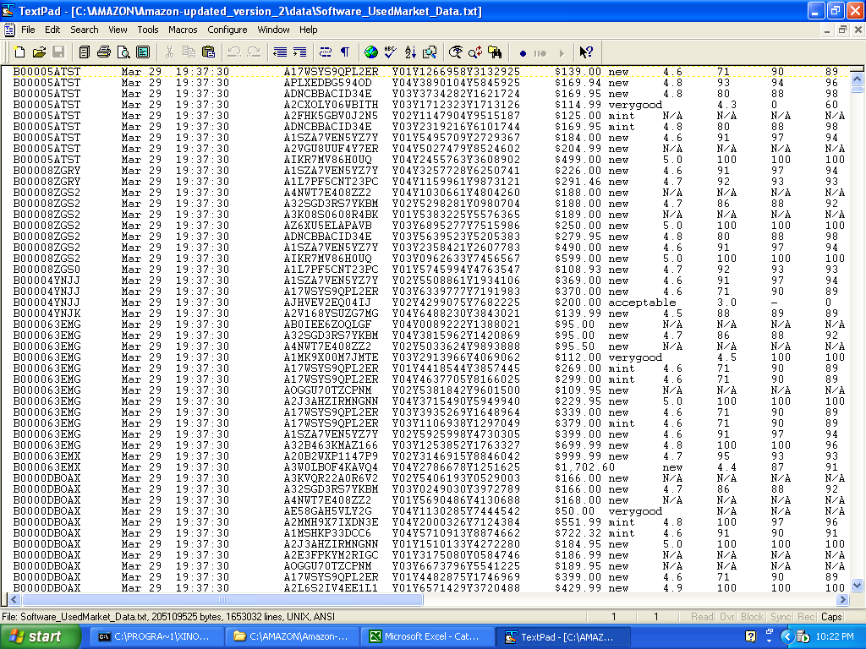
Data: Transactions
Capturing transactions and “price premiums”
Seller
Item
Listing
Price
When item is sold, listing disappears

Slide 44
Data: Transactions
Capturing transactions and “price premiums”
Jan 1
Jan 2
Jan 3
Jan 4
Jan 5
Jan 6
Jan 7
Jan 8
Jan 9
Jan 10
time
While listing appears, item is still available

Slide 45
Data: Transactions
Capturing transactions and “price premiums”
Jan 1
Jan 2
Jan 3
Jan 4
Jan 5
Jan 6
Jan 7
Jan 8
Jan 9
Jan 10
time
Item still not sold on 1/7
While listing appears, item is still available

Slide 46
Data: Transactions
Capturing transactions and “price premiums”
Jan 1
Jan 2
Jan 3
Jan 4
Jan 5
Jan 6
Jan 7
Jan 8
Jan 9
Jan 10
time
Item sold on 1/9
When item is sold, listing disappears

Slide 47

Reputation Pricing Tool for Sellers
Canon Powershot x300
Your competitive landscape
Product Price (reputation)
Seller: uCameraSite.com
Seller 1 - $431
(4.8)
Your last 5 transactions in
Cameras
Seller 2 - $409
(4.65)
Name of product Price
You - $399
$20
(4.7)
Canon Powershot x300
Kodak - EasyShare 5.0MP
Nikon - Coolpix 5.1MP
Fuji FinePix 5.1
Canon PowerShot x900
Seller 3 - $382
(3.9)
Seller 4-$379
(3.6)
Seller 5-$376
(3.4)
Your Price: $399
Your Reputation Price: $419
Your Reputation Premium: $20 (5%)
Left on the table

Slide 48
RSI Tool for Seller Reputation Management
Quantitatively Understand & Manage Seller Reputation
How your customers see you relative to other sellers:
Dimensions of your reputation and the relative importance to your customers:
Service
35%*
Delivery
Packaging
69%
Service
Delivery
89%
Quality
95%
Quality
Packaging
Overall
82%
Other
* Percentile of all merchants
RSI Products Automatically Identify the Dimensions of Reputation from Textual Feedback
Dimensions are Quantified Relative to Other Sellers and Relative to Buyer Importance
Sellers can Understand their Key Dimensions of Reputation and Manage them over Time
Arms Sellers with Vital Info to Compete on Reputation Dimensions other than Low Price.

Slide 49
Buyer’s Tool
Marketplace Search
Dimension Comparison
Canon PS SD700
Price
Service
Package
Delivery
Used Market (ex: Amazon)
Seller 1
Seller 2
Price
Price Range $250-$300
Seller 3
Service
Seller 1
Seller 2
Seller 4
Packaging
Seller 4
Seller 3
Seller 5
Delivery
Seller 6
Seller 7
Sort by Price/Service/Delivery/other dimensions

Slide 50
Data
Overview
Panel of 280 software products sold by Amazon.com X 180 days
Data from “used goods” market
  Amazon Web services facilitate capturing transactions
  We do not use any proprietary Amazon data (Details in the paper)

Slide 51
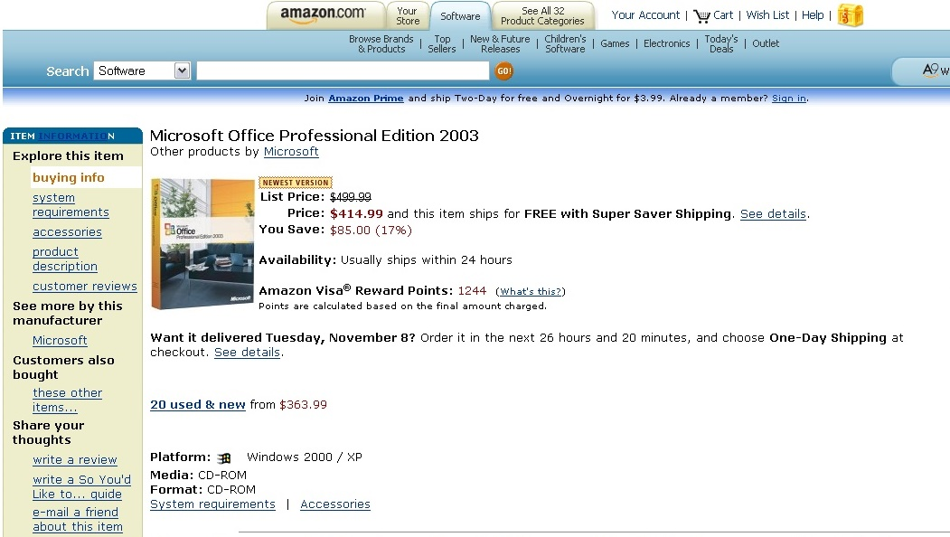
Data: Secondary Marketplace

Slide 52
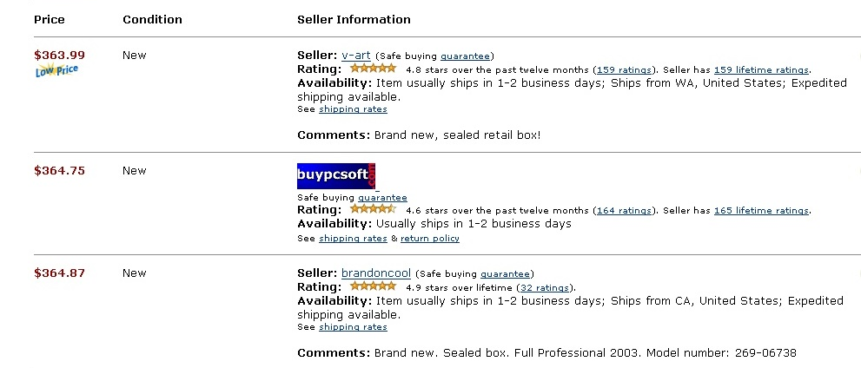
Data: Capturing Transactions
Jan 1
Jan 2
Jan 3
Jan 4
Jan 5
Jan 6
Jan 7
Jan 8
time
We repeatedly “crawl” the marketplace using Amazon Web Services
While listing appears  item is still available  no sale
Notes:
92% are new

Slide 53
Data: Capturing Transactions
Jan 1
Jan 2
Jan 3
Jan 4
Jan 5
Jan 6
Jan 7
Jan 8
Jan 9
Jan 10
time
We repeatedly “crawl” the marketplace using Amazon Web Services
When listing disappears  item sold
Notes:
92% are new

Slide 54
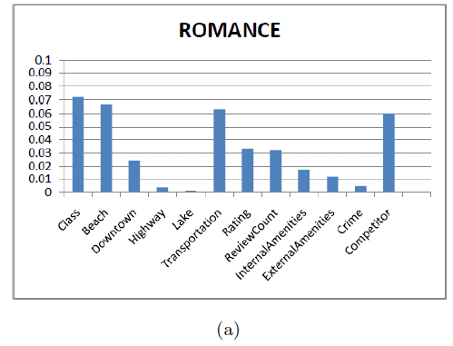
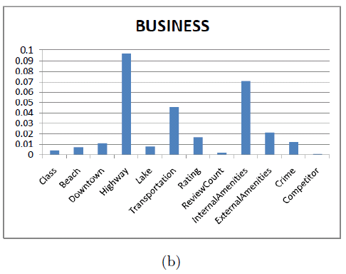
Weights of Hotel Characteristics
Based on Different Travel Purposes
Consumers with different travel purposes assign different weight distributions on the same set of hotel characteristics.

Slide 55
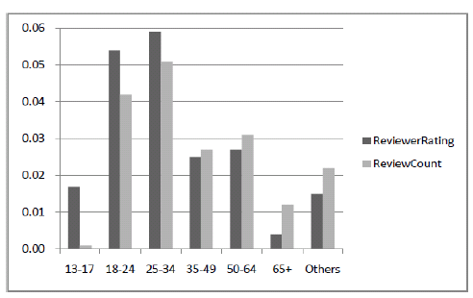
Sensitivity to Rating and Review Count Based on Different Age Groups
Age 18-34 pay more attention to online reviews compared to other age groups.

Slide 56
User Study
Experiment 1: Blind pair-wise comparisons, 100 anonymous AMT users;
8 existing baselines:
-Price low to high
-Price high to low
-Online review count
-Hotel class
-Hotel size (number of rooms
-Number of internal amenities
-TripAdvisor reviewer rating
-Travelocity reviewer rating
Conclusion: CS-based ranking is overwhelmingly preferred.
Reasoning: Diversity, satisfies consumers’ multidimensional preferences

Slide 57
User Study
Experiment 2: Blind pair-wise comparisons, 100 anonymous AMT users;
baseline: generalized CS-based ranking (for an average consumer).
E.g., Business trip and family trip AMT user study results in the NYC experiment.
Conclusion: Personalized CS-based ranking is overwhelmingly preferred.
Reasoning: Capture consumers’ specific expectations, dovetail with their real purchase motivation.

Slide 58
Estimation Results Capture Real Motivation
e.g., Business travelers indicated that they prefer quiet inner environment and easy access to highway or public transportation. This was fully captured in our estimation results, see (b).

