Slide 1
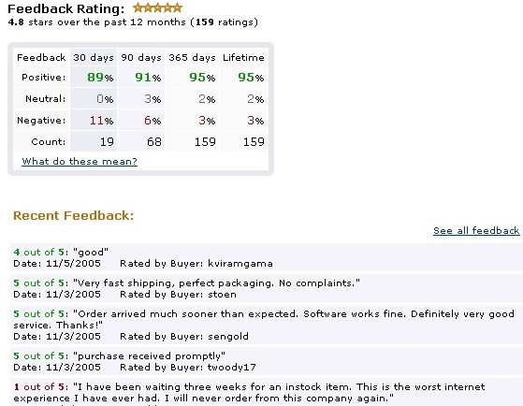
Opinion Mining using Econometrics
A Case Study on Reputation Systems
Panos Ipeirotis
Stern School of Business
New York University
Join work with Anindya Ghose
and Arun Sundararajan

Slide 2
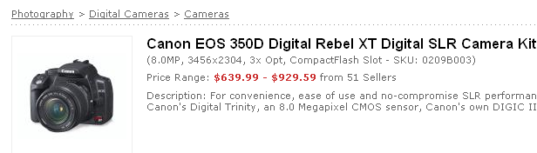
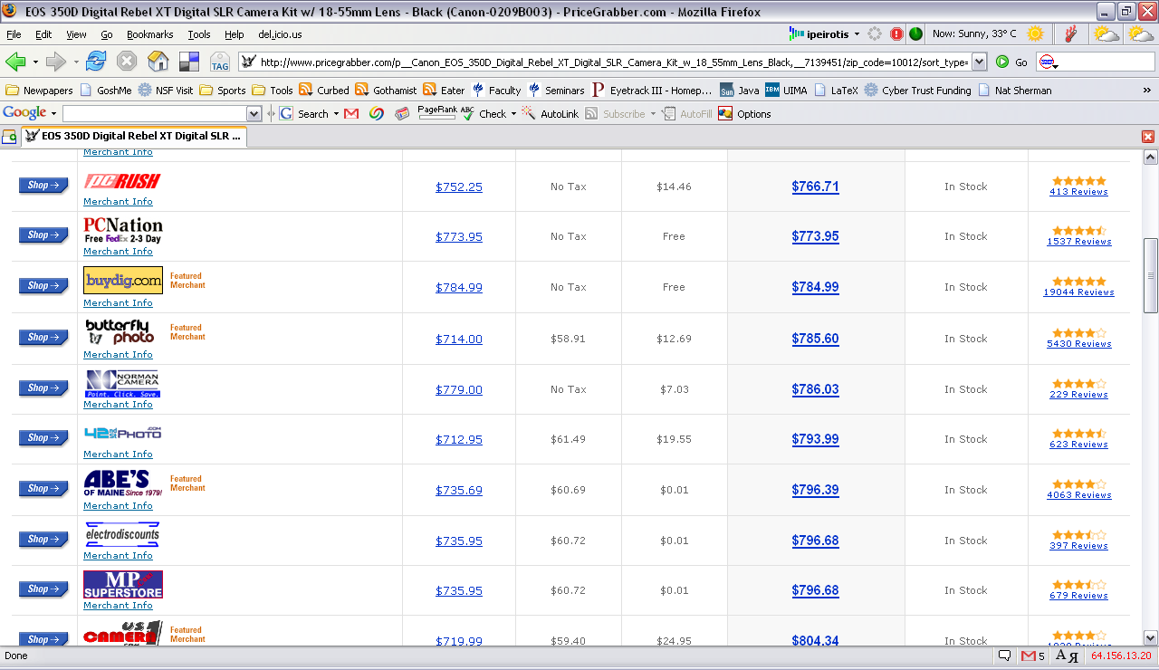
Comparative Shopping in e-Marketplaces

Slide 3
Customers Rarely Buy Cheapest Item

Slide 4
Are Customers Irrational?
BuyDig.com gets
Price Premiums
(customers pay more than
the minimum price)
$18.28
$11.04
-$0.61
-$1.04
-$9.00
-$11.40

Slide 5
Price Premiums @ Amazon
Are Customers Irrational (?)

Slide 6
Why not Buying the Cheapest?
You buy more than a product
Customers do not pay only for the product
Customers also pay for a set of fulfillment characteristics
  Delivery
  Packaging
  Responsiveness
  …
Customers care about reputation of sellers!

Slide 7
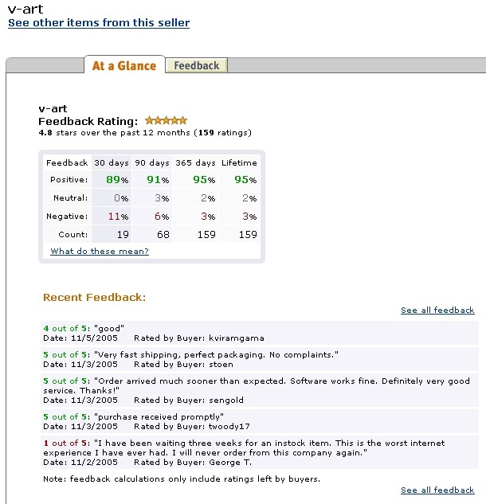
Example of a reputation profile

Slide 8
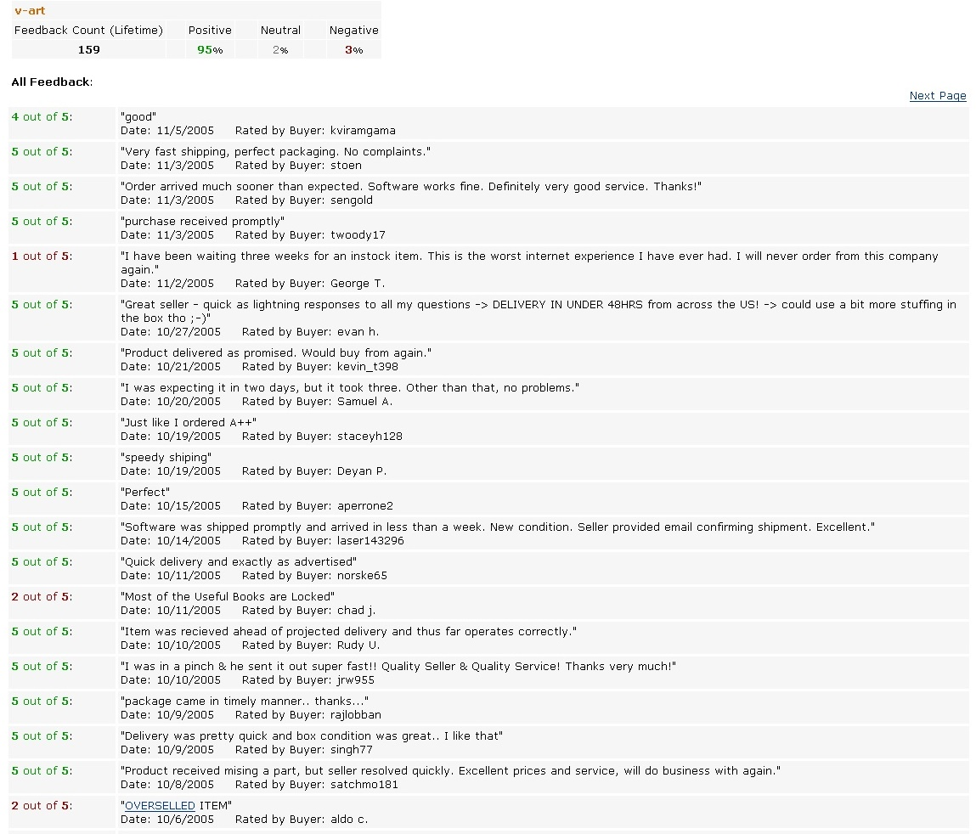

Slide 9
Our Contribution in a Single Slide
Our conjecture:
Price premiums measure reputation
Reputation is captured in text feedback
Our contribution:
Examine how text affects price premiums
(and do sentiment analysis as a side effect)

Slide 10
Outline
How we capture price premiums
How we structure text feedback
How we connect price premiums and text

Slide 11
Data
Overview
Panel of 280 software products sold by Amazon.com X 180 days
Data from “used goods” market
  Amazon Web services facilitate capturing transactions
  We do not use any proprietary Amazon data (Details in the paper)

Slide 12
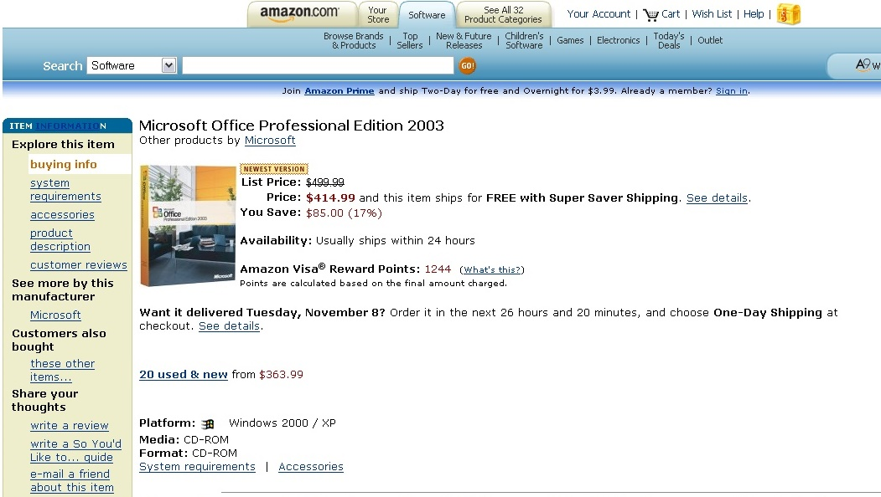
Data: Secondary Marketplace

Slide 13
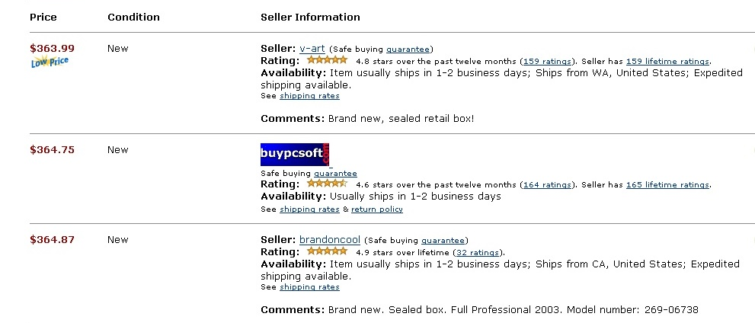
Data: Capturing Transactions
Jan 1
Jan 2
Jan 3
Jan 4
Jan 5
Jan 6
Jan 7
Jan 8
time
We repeatedly “crawl” the marketplace using Amazon Web Services
While listing appears  item is still available  no sale
Notes:
92% are new

Slide 14
Data: Capturing Transactions
Jan 1
Jan 2
Jan 3
Jan 4
Jan 5
Jan 6
Jan 7
Jan 8
Jan 9
Jan 10
time
We repeatedly “crawl” the marketplace using Amazon Web Services
When listing disappears  item sold
Notes:
92% are new

Slide 15
Data: Variables of Interest
Price Premium
Difference of price charged by a seller minus listed price of a competitor
  Price Premium = (Seller Price – Competitor Price)
Calculated for each seller-competitor pair, for each transaction
Each transaction generates M observations, (M: number of competing sellers)
Alternative Definitions:
  Average Price Premium (one per transaction)
  Relative Price Premium (relative to seller price)
  Average Relative Price Premium (combination of the above)

Slide 16
Price premiums @ Amazon

Slide 17
Average price premiums @ Amazon

Slide 18
Outline
How we capture price premiums
How we structure text feedback
How we connect price premiums and text

Slide 19
Decomposing Reputation
Is reputation just a scalar metric?
Previous studies assumed a “monolithic” reputation
We break down reputation in individual components
Sellers characterized by a set of fulfillment characteristics
(packaging, delivery, and so on)
What are these characteristics (valued by consumers?)
We think of each characteristic as a dimension, represented by a noun, noun phrase, verb or verbal phrase (“shipping”, “packaging”, “delivery”, “arrived”)
We scan the textual feedback to discover these dimensions

Slide 20
Decomposing and Scoring Reputation
Decomposing and scoring reputation
We think of each characteristic as a dimension, represented by a noun or verb phrase (“shipping”, “packaging”, “delivery”, “arrived”)
The sellers are rated on these dimensions by buyers using modifiers (adjectives or adverbs), not numerical scores
  “Fast shipping!”
  “Great packaging”
  “Awesome unresponsiveness”
  “Unbelievable delays”
  “Unbelievable price”
How can we find out the meaning of these adjectives?

Slide 21
Structuring Feedback Text: Example
Parsing the feedback
  P1: I was impressed by the speedy delivery! Great Service!
  P2: The item arrived in awful packaging, but the delivery was speedy
Deriving reputation score
We assume that a modifier assigns a “score” to a dimension
α(μ, k): score associated when modifier μ evaluates the k-th dimension
w(k): weight of the k-th dimension
Thus, the overall (text) reputation score Π(i) is a sum:
Π(i) = 2*α (speedy, delivery) * weight(delivery)+
1*α (great, service) * weight(service) +
1*α (awful, packaging) * weight(packaging)
unknown?
unknown

Slide 22
Outline
How we capture price premiums
How we structure text feedback
How we connect price premiums and text

Slide 23
Sentiment Scoring with Regressions
Scoring the dimensions
Use price premiums as “true” reputation score Π(i)
Use regression to assess scores (coefficients)
Π(i) = 2*α (speedy, delivery) * weight(delivery)+
1*α (great, service) * weight(service) +
1*α (awful, packaging) * weight(packaging)
Price
Premium
estimated coefficients
Regressions
Control for all variables that affect price premiums
Control for all numeric scores of reputation
Examine effect of text: E.g., seller with “fast delivery” has premium $10 over seller with “slow delivery”, everything else being equal
 “fast delivery” is $10 better than “slow delivery”

Slide 24
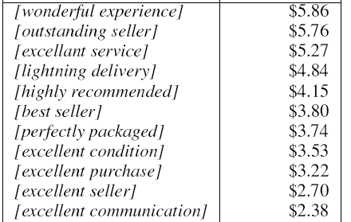
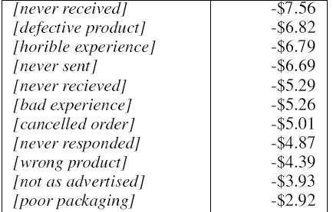
Some Indicative Dollar Values
Positive
Negative
captures misspellings as well
Natural method for extracting sentiment strength and polarity
good packaging
-$0.56
Positive?
Negative
?
Naturally captures the pragmatic meaning within the given context

Slide 25
Results
Some dimensions that matter
Delivery and contract fulfillment (extent and speed)
Product quality and appropriate description
Packaging
Customer service
Price (!)
Responsiveness/Communication (speed and quality)
Overall feeling (transaction)

Slide 26
More Results
Further evidence: Who will make the sale?
Classifier that predicts sale given set of sellers
Binary decision between seller and competitor
Used Decision Trees (for interpretability)
Training on data from Oct-Jan, Test on data from Feb-Mar
Only prices and product characteristics: 55%
+ numerical reputation (stars), lifetime: 74%
+ encoded textual information: 89%
text only: 87%
Text carries more information than the numeric metrics

Slide 27
Other applications
Summarize and query reputation data
Give me all merchants that deliver fast
  SELECT merchant FROM reputation
  WHERE delivery > ‘fast’
Summarize reputation of seller XYZ Inc.
  Delivery: 3.8/5
  Responsiveness: 4.8/5
  Packaging: 4.9/5
Pricing reputation
Given the competition, merchant XYZ can charge $20 more and still make the sale (confidence: 83%)

Slide 28

Reputation Pricing Tool for Sellers
Canon Powershot x300
Your competitive landscape
Product Price (reputation)
Seller: uCameraSite.com
Seller 1 - $431
(4.8)
Your last 5 transactions in
Cameras
Seller 2 - $409
(4.65)
Name of product Price
You - $399
$20
(4.7)
Canon Powershot x300
Kodak - EasyShare 5.0MP
Nikon - Coolpix 5.1MP
Fuji FinePix 5.1
Canon PowerShot x900
Seller 3 - $382
(3.9)
Seller 4-$379
(3.6)
Seller 5-$376
(3.4)
Your Price: $399
Your Reputation Price: $419
Your Reputation Premium: $20 (5%)
Left on the table

Slide 29
RSI Tool for Seller Reputation Management
Quantitatively Understand & Manage Seller Reputation
How your customers see you relative to other sellers:
Dimensions of your reputation and the relative importance to your customers:
Service
35%*
Delivery
Packaging
69%
Service
Delivery
89%
Quality
95%
Quality
Packaging
Overall
82%
Other
* Percentile of all merchants
RSI Products Automatically Identify the Dimensions of Reputation from Textual Feedback
Dimensions are Quantified Relative to Other Sellers and Relative to Buyer Importance
Sellers can Understand their Key Dimensions of Reputation and Manage them over Time
Arms Sellers with Vital Info to Compete on Reputation Dimensions other than Low Price.

Slide 30
Buyer’s Tool
Marketplace Search
Dimension Comparison
Canon PS SD700
Price
Service
Package
Delivery
Used Market (ex: Amazon)
Seller 1
Seller 2
Price
Price Range $250-$300
Seller 3
Service
Seller 1
Seller 2
Seller 4
Packaging
Seller 4
Seller 3
Seller 5
Delivery
Seller 6
Seller 7
Sort by Price/Service/Delivery/other dimensions

Slide 31

Show me the Money!
Broader contribution
Economic data appear in many contexts and there is rich literature on how to handle such data
Other Applications
Reputation was an easy case (both for NLP and econometrics)
Product Reviews and Product Sales (KDD’07, Archack et al.)
  Much longer text, data sparseness problems
Financial News and Stock Option Prices
  No “sentiment”; need to estimate effect of actual facts
Political News and Prediction Markets
Product Description Summary and Product Sales
  Optimal summary length and contents depends on what maximizes profit

Slide 32


Product Reviews and Product Sales
Examine changes in demand and estimate weights of features and strength of evaluations
“excellent lenses”
“excellent photos”
+3%
+6%
“poor lenses”
“poor photos”
-1%
-2%
Feature “photos” is two time more important than “lenses”
“Excellent” is positive, “poor” is negative
“Excellent” is three times stronger than “poor”

Slide 33
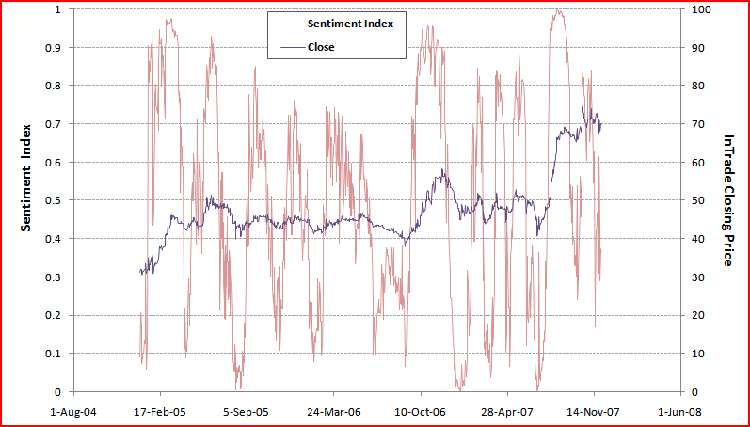
Political News and Prediction Markets
Hillary Clinton

Slide 34
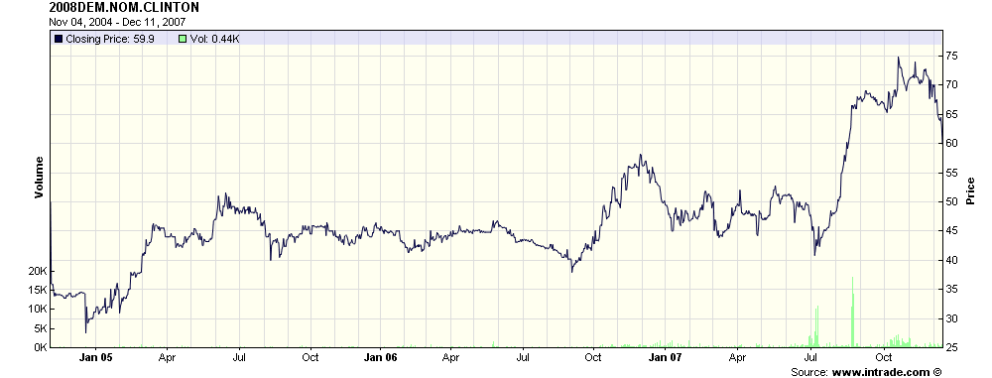
Political News and Prediction Markets

Slide 35
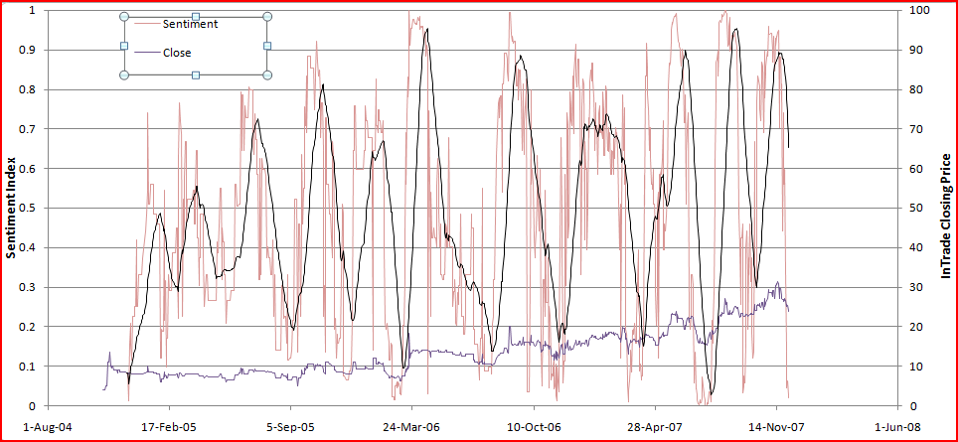
Political News and Prediction Markets
Mitt Romney

Slide 36
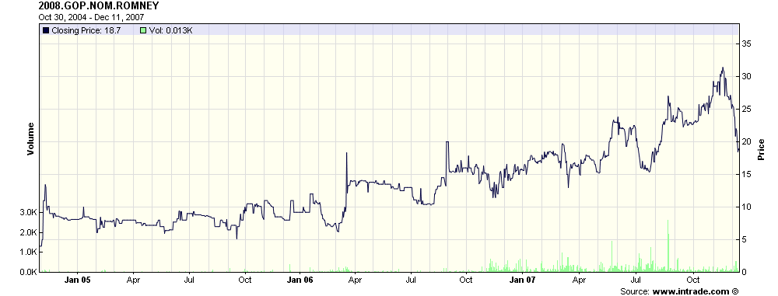
Political News and Prediction Markets

Slide 37
Thank you! Questions?
http://economining.stern.nyu.edu

Slide 38
Overflow Slides

Slide 39
Relative Price Premiums

Slide 40
Average Relative Price Premiums

Slide 41
Other applications
Summarize and query reputation data
Give me all merchants that deliver fast
  SELECT merchant FROM reputation
  WHERE delivery > ‘fast’
Summarize reputation of seller XYZ Inc.
  Delivery: 3.8/5
  Responsiveness: 4.8/5
  Packaging: 4.9/5
Pricing reputation
Given the competition, merchant XYZ can charge $20 more and still make the sale (confidence: 83%)

Slide 42
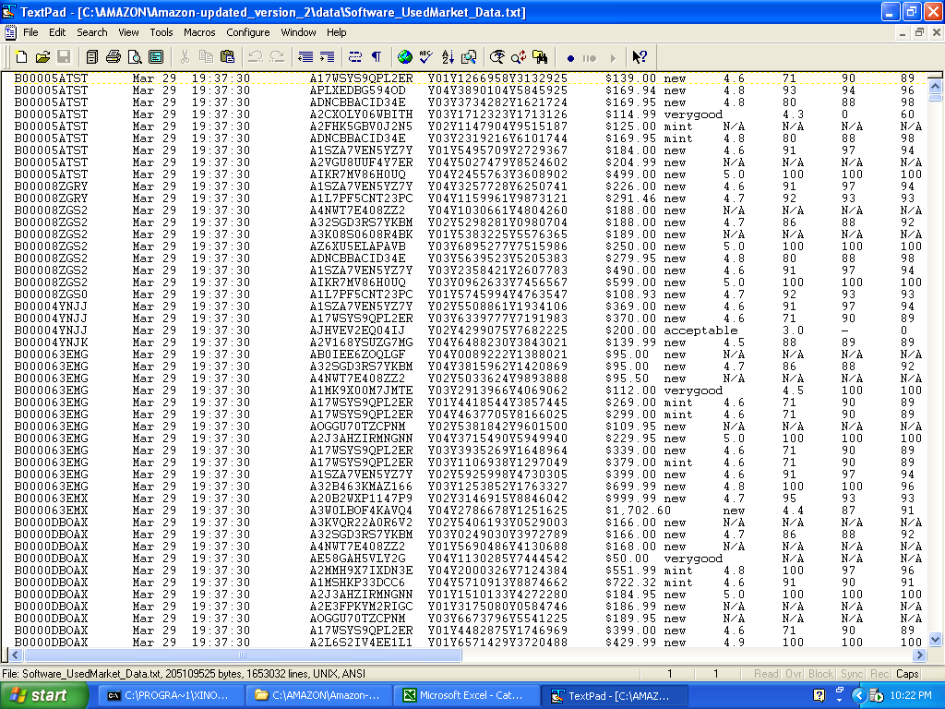
Data: Transactions
Capturing transactions and “price premiums”
Seller
Item
Listing
Price
When item is sold, listing disappears

Slide 43
Data: Transactions
Capturing transactions and “price premiums”
Jan 1
Jan 2
Jan 3
Jan 4
Jan 5
Jan 6
Jan 7
Jan 8
Jan 9
Jan 10
time
While listing appears, item is still available

Slide 44
Data: Transactions
Capturing transactions and “price premiums”
Jan 1
Jan 2
Jan 3
Jan 4
Jan 5
Jan 6
Jan 7
Jan 8
Jan 9
Jan 10
time
Item still not sold on 1/7
While listing appears, item is still available

Slide 45
Data: Transactions
Capturing transactions and “price premiums”
Jan 1
Jan 2
Jan 3
Jan 4
Jan 5
Jan 6
Jan 7
Jan 8
Jan 9
Jan 10
time
Item sold on 1/9
When item is sold, listing disappears

Slide 46
Our research questions
What are the dimensions of online reputation?
What characteristics comprise the important parts of a seller’s overall reputation? (politeness? packaging? delivery?)
How to evaluate the reputation across these dimensions?
How can we measure the reputation across each dimension?
How can we measure polarity and strength of each individual evaluation?
  Is good service better than ok service?
  Is superfast delivery faster than supersuperfast delivery?
  Is good packaging a positive evaluation?
Can prior reputation predict marketplace outcomes?
Given a set of sellers, their reputations, and their prices, can one predict which seller will successfully make the sale?

Slide 47
Reputation profiles: Observations
Reputation in ecommerce is complex
Different buyers value different fulfillment characteristics
Sellers have varying abilities on these characteristics
Previous work studied only effect of “average score” and “lifetime”
Reputation profile capture more than “averages”
Well beyond “average score” and “lifetime”
Rich textual content: information about a seller on a variety of dimensions (fulfillment characteristics).
How the seller’s performance (potentially on each of these characteristics) has evolved over time
Buyer-seller networks

