Slide 1
Crowdsourcing using Mechanical Turk: Quality Management and Scalability
Panos Ipeirotis
New York University
Twitter: @ipeirotis
“A Computer Scientist in a Business School” http://behind-the-enemy-lines.com
Joint work with: Jing Wang, Foster Provost, Josh Attenberg, and Victor Sheng; Special thanks to AdSafe Media
Notes:
Micro-outsourcing systems (like AMT, RentaCoder, oDesk, and many more) have changed the cost/benefit landscape for data analytics. Certain sorts of data can be acquired much more cheaply—but the data quality may be suspect.

Slide 2
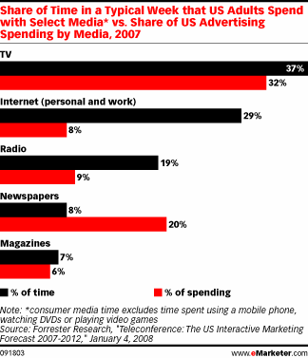
Notes:
total media ad spending is about $300B
laments about poor “performance” of ads on social networking sites are criticisms of direct marketing-style advertising, as well as click-based evaluations.

Slide 6
A few of the tasks in the past
Detect pages that discuss swine flu
Pharmaceutical firm had drug “treating” (off-label) swine flu
FDA prohibited pharmaceutical company to display drug ad in pages about swine flu
Two days to build and go live
Big fast-food chain does not want ad to appear:
In pages that discuss the brand (99% negative sentiment)
In pages discussing obesity
Three days to build and go live

Slide 7
Need to build models fast
Traditionally, modeling teams have invested substantial internal resources in data formulation, information extraction, cleaning, and other preprocessing
No time for such things…
However, now, we can outsource preprocessing tasks, such as labeling, feature extraction, verifying information extraction, etc.
using Mechanical Turk, oDesk, etc.
quality may be lower than expert labeling (much?)
but low costs can allow massive scale
7
Notes:
pay for expert labeling?
alternative setting to active learning – where labeling is very costly
7

Slide 8
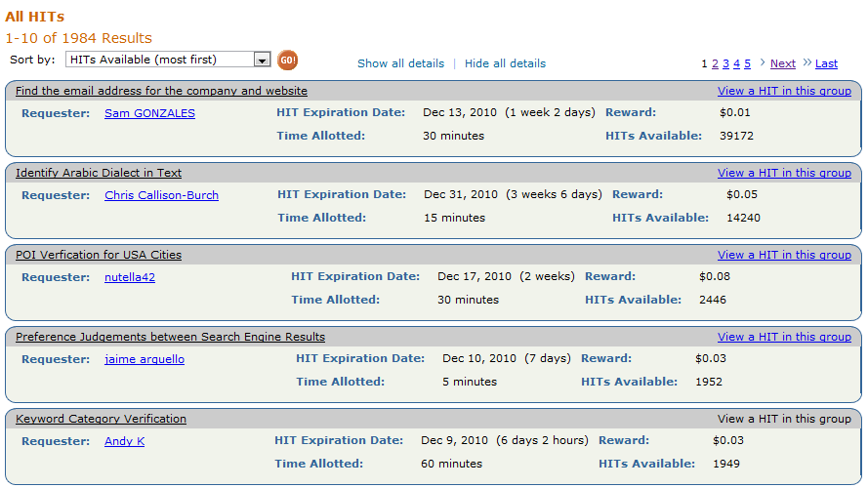
Amazon Mechanical Turk

Slide 9
Need to build models fast
Using Mechanical Turk:
To find URLs for a given topic (hate speech, gambling, alcohol abuse, guns, bombs, celebrity gossip, etc etc) http://url-collector.appspot.com/allTopics.jsp [“Guided Learning”, applicable when class prior small]
To classify URLs into appropriate categories http://url-annotator.appspot.com/AdminFiles/Categories.jsp
9
Notes:
pay for expert labeling?
alternative setting to active learning – where labeling is very costly
9

Slide 10
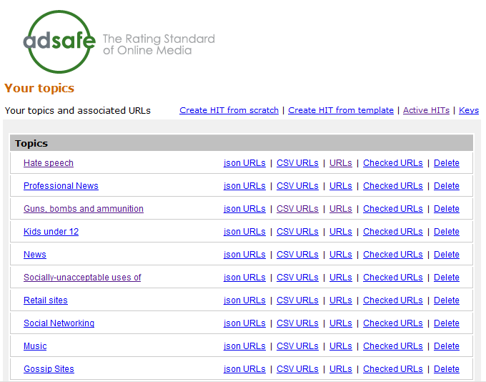
URL Collector

Slide 11
Example: Build an “Adult Web Site” Classifier
Need a large number of hand-labeled sites
Get people to look at sites and classify them as:
G (general audience) PG (parental guidance) R (restricted) X (porn)
Cost/Speed Statistics
Undergrad intern: 200 websites/hr, cost: $15/hr
MTurk: 2500 websites/hr, cost: $12/hr

Slide 13
Bad news: Spammers!
Worker ATAMRO447HWJQ
labeled X (porn) sites as G (general audience)

Slide 14
Redundant votes, infer quality
Look at our spammer friend ATAMRO447HWJQ together with other 9 workers
Using redundancy, we can compute error rates for each worker

Slide 15
Algorithm of (Dawid & Skene, 1979) [and many recent variations on the same theme]
Iterative process to estimate worker error rates
Initialize“correct” label for each object (e.g., use majority vote)
Estimate error rates for workers (using “correct” labels)
Estimate “correct” labels (using error rates, weight worker votes according to quality)
Go to Step 2 and iterate until convergence
Error rates for ATAMRO447HWJQ
P[G → G]=99.947% P[G → X]=0.053%
P[X → G]=99.153% P[X → X]=0.847%
Our friend ATAMRO447HWJQ marked almost all sites as G. Seems like a spammer…

Slide 16
Challenge: From Confusion Matrixes to Quality Scores
The algorithm generates “confusion matrixes” for workers
Error rates for ATAMRO447HWJQ
P[X → X]=0.847% P[X → G]=99.153%
P[G → X]=0.053% P[G → G]=99.947%
How to check if a worker is a spammer using the confusion matrix?
(hint: error rate not enough)

Slide 17
Challenge 1: Spammers are lazy and smart!
Confusion matrix for spammer
P[X → X]=0% P[X → G]=100%
P[G → X]=0% P[G → G]=100%
Confusion matrix for good worker
P[X → X]=80% P[X → G]=20%
P[G → X]=20% P[G → G]=80%
Spammers figure out how to fly under the radar…
In reality, we have 85% G sites and 15% X sites
Errors of spammer = 0% * 85% + 100% * 15% = 15%
Error rate of good worker = 85% * 20% + 85% * 20% = 20%
False negatives: Spam workers pass as legitimate

Slide 18
Challenge 2: Humans are biased!
Error rates for CEO of AdSafe
P[G → G]=20.0% P[G → P]=80.0% P[G → R]=0.0% P[G → X]=0.0%
P[P → G]=0.0% P[P → P]=0.0% P[P → R]=100.0% P[P → X]=0.0%
P[R → G]=0.0% P[R → P]=0.0% P[R → R]=100.0% P[R → X]=0.0%
P[X → G]=0.0% P[X → P]=0.0% P[X → R]=0.0% P[X → X]=100.0%
In reality, we have 85% G sites, 5% P sites, 5% R sites, 5% X sites
Errors of spammer (all in G) = 0% * 85% + 100% * 15% = 15%
Error rate of biased worker = 80% * 85% + 100% * 5% = 73%
False positives: Legitimate workers appear to be spammers

Slide 19
Solution: Reverse errors first, compute error rate afterwards
Error Rates for CEO of AdSafe
P[G → G]=20.0% P[G → P]=80.0% P[G → R]=0.0% P[G → X]=0.0%
P[P → G]=0.0% P[P → P]=0.0% P[P → R]=100.0% P[P → X]=0.0%
P[R → G]=0.0% P[R → P]=0.0% P[R → R]=100.0% P[R → X]=0.0%
P[X → G]=0.0% P[X → P]=0.0% P[X → R]=0.0% P[X → X]=100.0%
When biased worker says G, it is 100% G
When biased worker says P, it is 100% G
When biased worker says R, it is 50% P, 50% R
When biased worker says X, it is 100% X
Small ambiguity for “R-rated” votes but other than that, fine!

Slide 20
Solution: Reverse errors first, compute error rate afterwards
Error Rates for spammer: ATAMRO447HWJQ
P[G → G]=100.0% P[G → P]=0.0% P[G → R]=0.0% P[G → X]=0.0%
P[P → G]=100.0% P[P → P]=0.0% P[P → R]=0.0% P[P → X]=0.0%
P[R → G]=100.0% P[R → P]=0.0% P[R → R]=0.0% P[R → X]=0.0%
P[X → G]=100.0% P[X → P]=0.0% P[X → R]=0.0% P[X → X]=0.0%
When spammer says G, it is 25% G, 25% P, 25% R, 25% X
When spammer says P, it is 25% G, 25% P, 25% R, 25% X
When spammer says R, it is 25% G, 25% P, 25% R, 25% X
When spammer says X, it is 25% G, 25% P, 25% R, 25% X
[note: assume equal priors]
The results are highly ambiguous. No information provided!

Slide 21
Quality Score
Expected Misclassification Cost
High cost: probability spread across classes
Low cost: “probability mass concentrated in one class
Assigned Label | “Soft” Label | Cost
G | <G: 25%, P: 25%, R: 25%, X: 25%> | 0.75
G | <G: 99%, P: 1%, R: 0%, X: 0%> | 0.0198
[***Assume equal misclassification costs]
Ipeirotis, Provost, Wang, HCOMP 2010

Slide 22
Quality Score
Quality Score
A spammer is a worker who always assigns labels randomly, regardless of what the true class is.
QualityScore is a scalar score, useful for the purpose of blocking bad workers and rewarding good ones
Essentially a multi-class, cost-sensitive performance metric

Slide 23
What about Gold testing?
Naturally integrated into the latent class model
Initialize by aggregating labels for each object (e.g., use majority vote)
Estimate error rates for workers (using aggregate labels)
Estimate aggregate labels (using error rates, weight worker votes according to quality)
Keep labels for “gold data” unchanged
Go to Step 2 and iterate until convergence

Slide 24
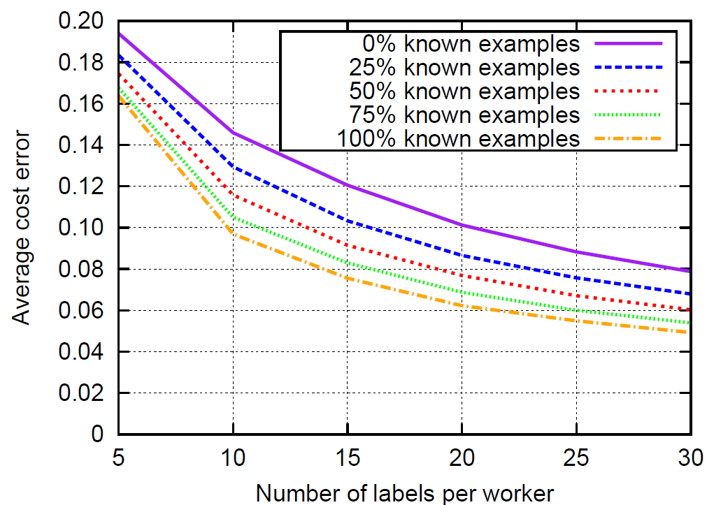
Gold Testing?
3 labels per example
2 categories, 50/50
Quality range: 0.55:0.05:1.0
200 labelers

Slide 25
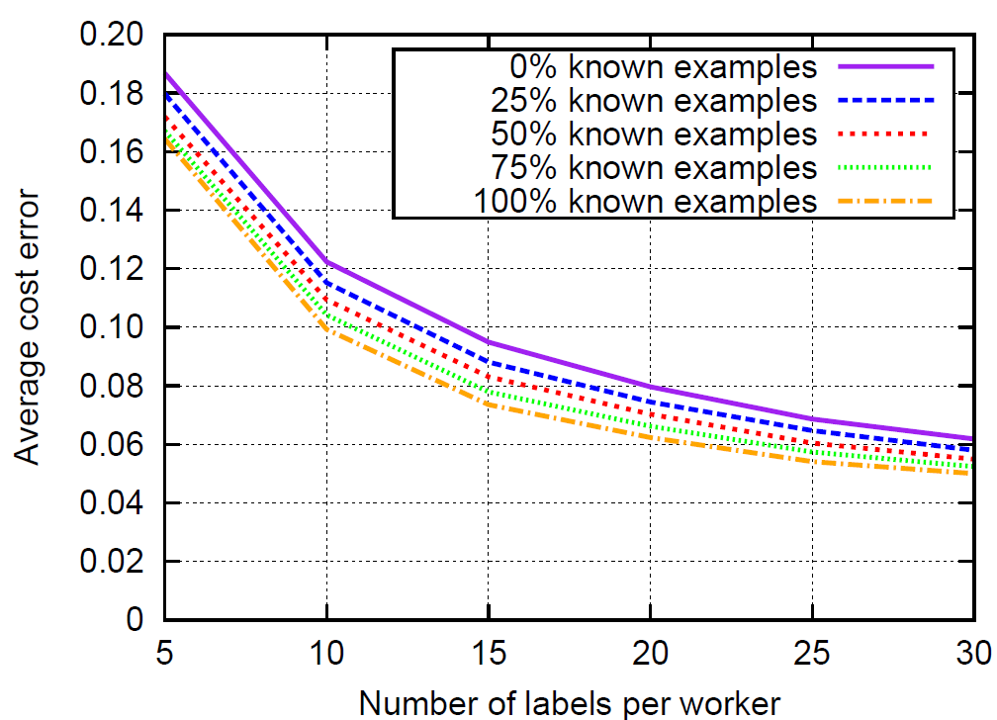
Gold Testing?
5 labels per example
2 categories, 50/50
Quality range: 0.55:0.05:1.0
200 labelers

Slide 26
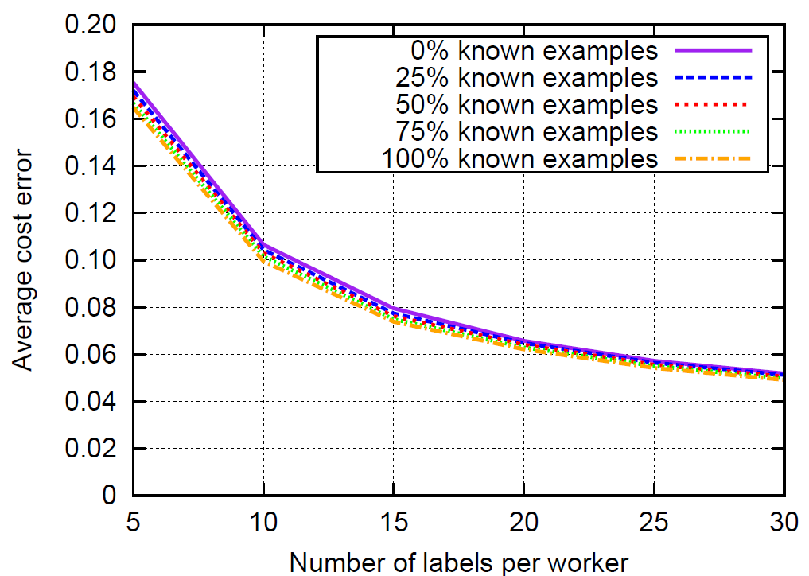
Gold Testing?
10 labels per example
2 categories, 50/50
Quality range: 0.55:0.05:1.0
200 labelers

Slide 27
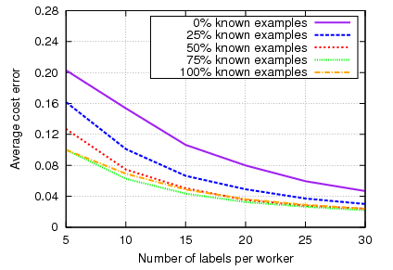
Gold Testing
10 labels per example
2 categories, 90/10
Quality range: 0.55:0.1.0
200 labelers
Advantage under imbalanced datasets

Slide 28
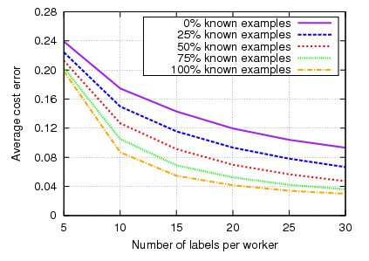
Gold Testing
5 labels per example
2 categories, 50/50
Quality range: 0.55:0.65
200 labelers
Advantage with bad worker quality

Slide 29
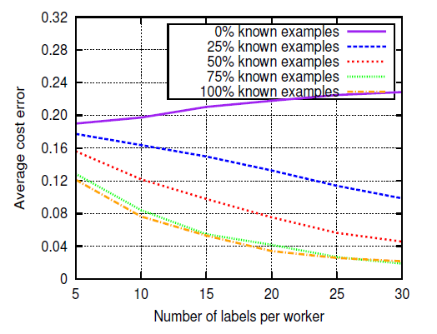
Gold Testing?
10 labels per example
2 categories, 90/10
Quality range: 0.55:0.65
200 labelers
Significant advantage under “bad conditions” (imbalanced datasets, bad worker quality)

Slide 30
Empirical Results and Observations
500 web pages in G, P, R, X, manually labeled
100 workers per page
339 workers
Lots of noise on MTurk. 100 votes per page:
95% accuracy with majority (only! -- Note massive amount of redundancy)
99.8% accuracy after modeling worker quality
Blocking based on error rate: Only 1% of labels dropped
Blocking based on quality scores: 30% of labels dropped
Majority vote gives same results after spammer removal

Slide 31
Too much theory?
Open source implementation available at:
http://code.google.com/p/get-another-label/
Input:
Labels from Mechanical Turk
Cost of incorrect labelings (e.g., X→G costlier than G→X)
Output:
Corrected labels
Worker error rates
Ranking of workers according to their quality
Beta version, more improvements to come!
Suggestions and collaborations welcomed!

Slide 32
Practical Deployment Lessons
Lesson 1: After kicking out spammers, majority vote undistinguishable from more advanced methods (but good to know the noise level, as we will see)
Lesson 2: Gold testing useful for spam detection but not for much else (wasting resources on workers that do not stick), but useful with imbalanced datasets and low-quality workers
Lesson 3: Slight benefit with having levels of workers
Level 2: Super-duper (80% and above) [not that many, however]
Level 1: Good (60% and above)
Level 0: Spammers and untrusted

Slide 33
Example: Build an “Adult Web Site” Classifier
Get people to look at sites and classify them as:
G (general audience) PG (parental guidance) R (restricted) X (porn)
But we are not going to label the whole Internet…
Expensive
Slow

Slide 34
Quality and Classification Performance
Noisy labels lead to degraded task performance
Labeling quality increases  classification quality increases
Quality = 100%
Quality = 80%
Quality = 60%
Quality = 50%
Single-labeler quality (probability of assigning correctly a binary label)

Slide 35
Majority Voting and Label Quality
Ask multiple labelers, keep majority label as “true” label
Quality is probability of being correct
P=1.0
P=0.9
P=0.8
P is probability of individual labeler being correct
P=0.7
P=0.6
P=0.5
P=0.4
Notes:
mention soft labeling? Or wait for a question?

Slide 36
Tradeoffs: More data or better data?
Get more examples  Improve classification
Get more labels  Improve label quality  Improve classification
Quality = 100%
Quality = 80 %
Quality = 60%
Quality = 50%
36
KDD 2008
Notes:
key: gradient in accuracy over example X quality space
complicated for various reasons, one of which is: labeling different examples will have different benefits
36

Slide 37
Basic Results
With high quality labelers (80% and above): One worker per case (more data better)
With low quality labelers (~60%) Multiple workers per case (to improve quality)

Slide 38
Selective Repeated-Labeling
We do not need to label everything the same way
Key observation: we have additional information to guide selection of data for repeated labeling
the current multiset of labels
Example: {+,-,+,-,-,+} vs. {+,+,+,+,+,+}
Notes:
if we’re getting a certain number of labels, how best to choose?

Slide 39
Natural Candidate: Entropy
Entropy is a natural measure of label uncertainty:
E({+,+,+,+,+,+})=0
E({+,-, +,-, -,+ })=1
Strategy: Get more labels for high-entropy label multisets

Slide 40
What Not to Do: Use Entropy
Entropy: Improves at first, hurts in long run

Slide 41
Why not Entropy
In the presence of noise, entropy will be high even with many labels
Entropy is scale invariant
{3+, 2-} has same entropy as {600+ , 400-}, i.e., 0.97

Slide 42
Bayesian Uncertainty per Example
If we knew worker quality q, we could estimate probability of each class, given p positive and n negative votes:
But we do not know q!
Let’s estimate first worker quality q for each example
Notes:
In computing our label uncertainty, we assumed that the majority of the mass of the estimated probability density over the labeler quality is on the correct side of the decision threshold. This might actually not be true with small numbers of labels OR in cases with high class skew (very common). Why in the latter case? Say p(-) >> p(+) and q is rather low. Then getting 2 or 3 + labels may be more likely due to labeler error than an indication that the correct class is probably +.

Slide 43
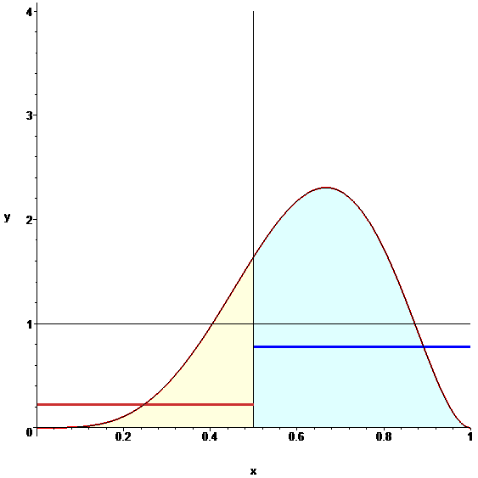
Bayesian Labeler Quality
Quality=0.7 (unknown)
5 labels (3+, 2-)
Entropy ~ 0.97
Observe +’s and –’s and estimate what is the noise level
Find the distribution of possible quality of labelers for the example

Slide 44
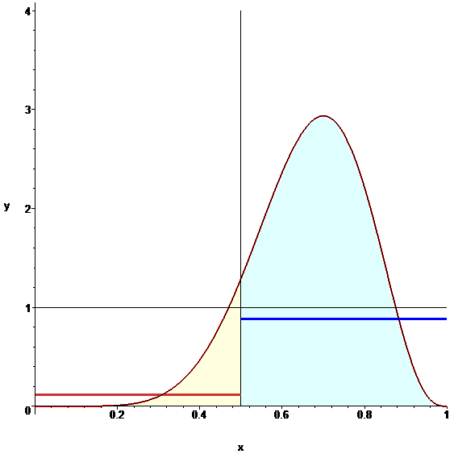
Bayesian Labeler Quality
Quality=0.7 (unknown)
10 labels (7+, 3-)
Entropy ~ 0.88
Observe +’s and –’s and estimate what is the noise level
Find the distribution of possible quality of labelers for the example

Slide 45
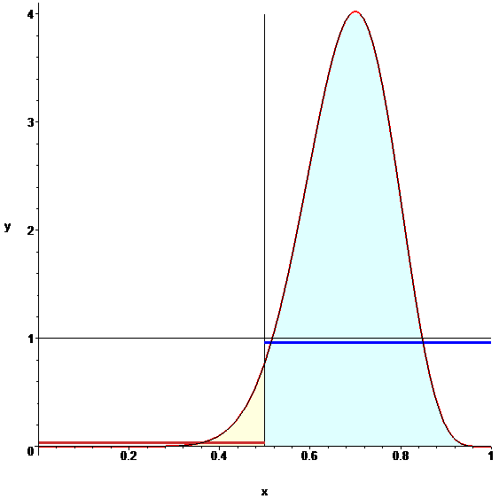
Bayesian Labeler Quality
Quality=0.7 (unknown)
20 labels (14+, 6-)
Entropy ~ 0.88
Observe +’s and –’s and estimate what is the noise level
Find the distribution of possible quality of labelers for the example

Slide 46
Computing Label Uncertainty
Once we know the (stochastic) quality of the workers, we can estimate Pr(+|pos, neg)
Allocate labels to cases with Pr(+|pos, neg) close to 0.5
Estimate the prior Pr(+) by iterating
Notes:
In computing our label uncertainty, we assumed that the majority of the mass of the estimated probability density over the labeler quality is on the correct side of the decision threshold. This might actually not be true with small numbers of labels OR in cases with high class skew (very common). Why in the latter case? Say p(-) >> p(+) and q is rather low. Then getting 2 or 3 + labels may be more likely due to labeler error than an indication that the correct class is probably +.

Slide 47
Another strategy: Model Uncertainty (MU)
+ +
- - - -
+ +
+ +
- - - -
+ +
- - - -
- - - -
+ +
+
+ +
+ +
- - - -
- - - -
+ +
- - - -
+ +
- - - -
+ +
Learning models of the data provides an alternative source of information about label certainty
Model uncertainty: get more labels for instances that cause model uncertainty
Intuition?
for modeling: why improve training data quality if model already is certain there?
for data quality, low-certainty “regions” may be due to incorrect labeling of corresponding instances
This is NOT active learning
Examples
Models
Self-healing process examines irregularities in training data
KDD 2008

Slide 48
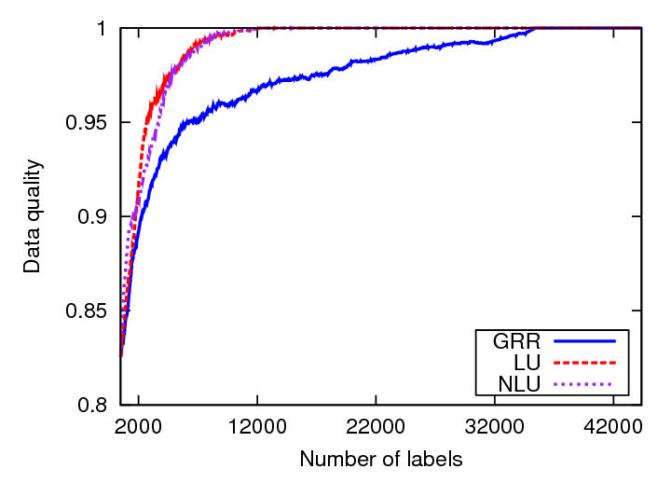
Adult content classification

Slide 49
Improving worker participation
With just labeling, workers are passively labeling whatever we give them
Why not asking them to search themselves?

Slide 50
Guided Learning
Ask workers to find example web pages (great for “sparse” content)
After collecting enough examples, easy to build and test web page classifier

Slide 51
Limits of Guided Learning
No incentives for workers to find “new” content
After a while, submitted web pages similar to already submitted ones
No improvement for classifier
51
Notes:
pay for expert labeling?
alternative setting to active learning – where labeling is very costly
51

Slide 52
The result? Peaceful ignorance…
Classifier seems great: Cross-validation tests show excellent performance
Alas, classifier fails: The “unknown unknowns” ™
52
Notes:
pay for expert labeling?
alternative setting to active learning – where labeling is very costly
52

Slide 53
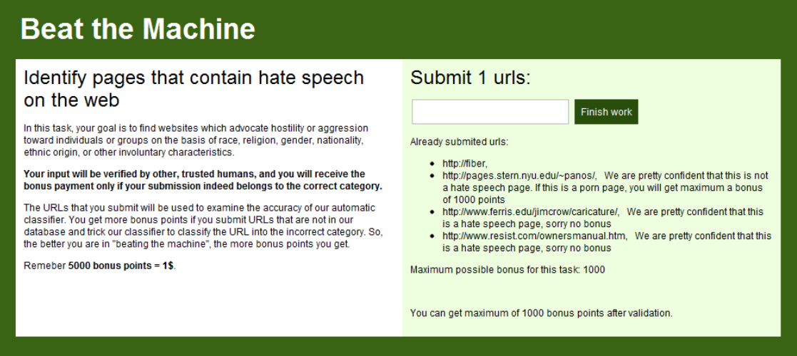
Beat the Machine!
Ask humans to find URLs that the classifier will miss
53
Example: Find hate speech pages that the machine will classify as benign
Notes:
53

Slide 54
Probes
Successes
Error rate for probes significantly higher than error rate on random data (10x to 100x)

Slide 55
Reward Structure
Once humans find the holes, they keep probing (e.g., multilingual porn ☺ )
After a while, we learn what we do not know (“unknown unknowns” → “known unknowns”)
Reward higher cases where:
Classifier confident (but wrong) and
We do not know it will be an error
55
Notes:
pay for expert labeling?
alternative setting to active learning – where labeling is very costly
55

Slide 56
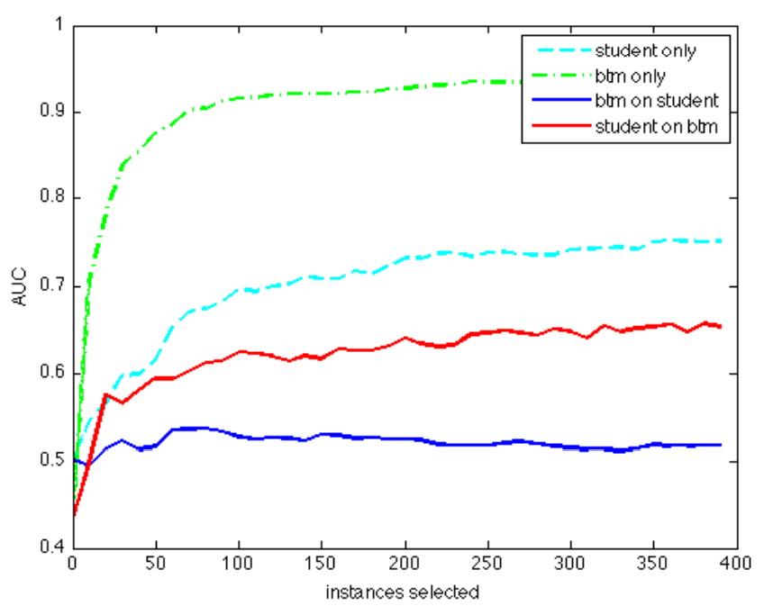
Structure of Successful Probes
Now, we identify errors much faster (and proactively)
Errors not random outliers: We can “learn” the errors
Could not, however, incorporate errors into existing classifier without degrading performance
56
Notes:
pay for expert labeling?
alternative setting to active learning – where labeling is very costly
56

Slide 57
Future Directions
Learn how to best incorporate knowledge to improve classifier
Measure prevalence of newly identified errors on the web (“query by document”)
Increase rewards for errors prevalent in the “generalized” case
57
Notes:
pay for expert labeling?
alternative setting to active learning – where labeling is very costly
57

Slide 58
Workers reacting to bad rewards/scores
Score-based feedback leads to strange interactions:
The “angry, has-been-burnt-too-many-times” worker:
“F*** YOU! I am doing everything correctly and you know it! Stop trying to reject me with your stupid ‘scores’!”
The overachiever worker:
“What am I doing wrong?? My score is 92% and I want to have 100%”

Slide 59
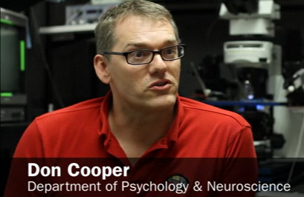
An unexpected connection at the NAS “Frontiers of Science” conf.
Your bad workers behave like my mice!

Slide 60
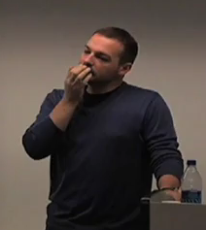
An unexpected connection at the NAS “Frontiers of Science” conf.
Your bad workers behave like my mice!
Eh?

Slide 61
An unexpected connection at the NAS “Frontiers of Science” conf.
Your bad workers want to engage their brain only for motor skills, not for cognitive skills
Yeah, makes sense…

Slide 62
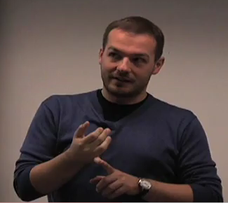
An unexpected connection at the NAS “Frontiers of Science” conf.
And here is how I train my mice to behave…
I should try this the moment that I get back to my room

Slide 63
Implicit Feedback using Frustration
Punish bad answers with frustration (e.g, delays between tasks)
“Loading image, please wait…”
“Image did not load, press here to reload”
“Network error. Return the HIT and accept again”
Reward good answers by giving next task immediately, with no problems
→Make this probabilistic to keep feedback implicit

Slide 64
First result
Spammer workers quickly abandon
Good workers keep labeling
Bad: Spammer bots unaffected
How to frustrate a bot?
Give it a CAPTHCA ☺

Slide 65
Second result (more impressive)
Remember, Don was training the mice…
15% of the spammers start submitting good work!
Putting cognitive effort is more beneficial …
Key trick: Learn to test workers on-the-fly
Model performance using Dirichlet compound multinomial distribution (details offline)

Slide 66
Thanks! Q & A?

