Slide 1
Crowdsourcing using Mechanical Turk: Quality Management and Scalability
Panos Ipeirotis
Stern School of Business
New York University
Twitter: @ipeirotis
“A Computer Scientist in a Business School” http://behind-the-enemy-lines.com
Joint work with: Jing Wang, Foster Provost, Josh Attenberg, and Victor Sheng; Special thanks to AdSafe Media
Notes:
Micro-outsourcing systems (like AMT, RentaCoder, oDesk, and many more) have changed the cost/benefit landscape for data analytics. Certain sorts of data can be acquired much more cheaply—but the data quality may be suspect.

Slide 2
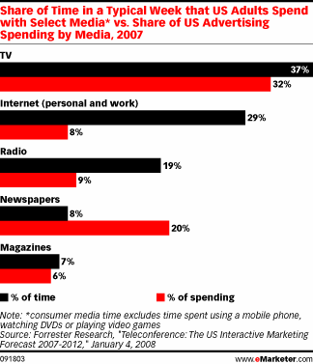
Notes:
total media ad spending is about $300B
laments about poor “performance” of ads on social networking sites are criticisms of direct marketing-style advertising, as well as click-based evaluations.

Slide 3
Gabrielle Giffords Shooting, Tucson, AZ, Jan 2011

Slide 6
Model needed within days
Pharmaceutical firm does not want ads to appear:
In pages pages that discuss swine flu (FDA prohibited pharmaceutical company to display drug ad in pages about swine flu)
Big fast-food chain does not want ads to appear:
In pages that discuss the brand (99% negative sentiment)
In pages discussing obesity, diabetes, cholesterol, etc
Airline company does not want ads to appear:
In pages with crashes, accidents, …
In pages with discussions of terrorist plots against airlines

Slide 7
Need to build models fast
Traditionally, modeling teams have invested substantial internal resources in data formulation, information extraction, cleaning, and other preprocessing
No time for such things…
However, now, we can outsource preprocessing tasks, such as labeling, feature extraction, verifying information extraction, etc.
using Mechanical Turk, oDesk, etc.
quality may be lower than expert labeling (much?)
but low costs can allow massive scale
7
Notes:
pay for expert labeling?
alternative setting to active learning – where labeling is very costly
7

Slide 8
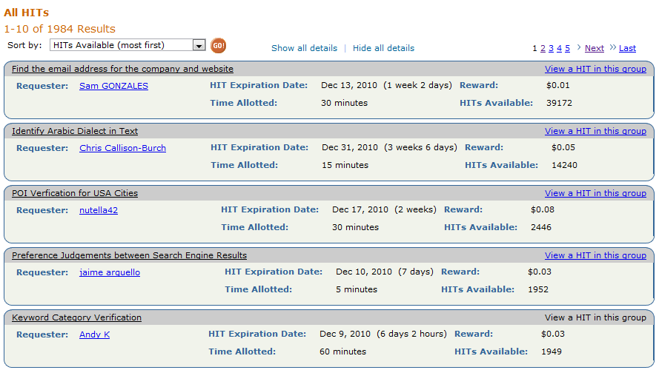
Amazon Mechanical Turk

Slide 9
Example: Build an “Adult Web Site” Classifier
Need a large number of hand-labeled sites
Get people to look at sites and classify them as:
G (general audience) PG (parental guidance) R (restricted) X (porn)
Cost/Speed Statistics
Undergrad intern: 200 websites/hr, cost: $15/hr
Mechanical Turk: 2500 websites/hr, cost: $12/hr

Slide 10
Bad news: Spammers!
Worker ATAMRO447HWJQ
labeled X (porn) sites as G (general audience)

Slide 11
Redundant votes, infer quality
Look at our spammer friend ATAMRO447HWJQ together with other 9 workers
Using redundancy, we can compute error rates for each worker

Slide 12
Algorithm of (Dawid & Skene, 1979) [and many recent variations on the same theme]
Iterative process to estimate worker error rates
Initialize“correct” label for each object (e.g., use majority vote)
Estimate error rates for workers (using “correct” labels)
Estimate “correct” labels (using error rates, weight worker votes according to quality)
Go to Step 2 and iterate until convergence
Error rates for ATAMRO447HWJQ
P[G → G]=99.947% P[G → X]=0.053%
P[X → G]=99.153% P[X → X]=0.847%
Our friend ATAMRO447HWJQ marked almost all sites as G. Seems like a spammer…

Slide 13
Challenge: From Confusion Matrixes to Quality Scores
Confusion Matrix for ATAMRO447HWJQ
P[X → X]=0.847% P[X → G]=99.153%
P[G → X]=0.053% P[G → G]=99.947%
How to check if a worker is a spammer using the confusion matrix?
(hint: error rate not enough)

Slide 14
Challenge 1: Spammers are lazy and smart!
Confusion matrix for spammer
P[X → X]=0% P[X → G]=100%
P[G → X]=0% P[G → G]=100%
Confusion matrix for good worker
P[X → X]=80% P[X → G]=20%
P[G → X]=20% P[G → G]=80%
Spammers figure out how to fly under the radar…
In reality, we have 85% G sites and 15% X sites
Error rate of spammer = 0% * 85% + 100% * 15% = 15%
Error rate of good worker = 85% * 20% + 85% * 20% = 20%
False negatives: Spam workers pass as legitimate

Slide 15
Challenge 2: Humans are biased!
Error rates for CEO of AdSafe
P[G → G]=20.0% P[G → P]=80.0% P[G → R]=0.0% P[G → X]=0.0%
P[P → G]=0.0% P[P → P]=0.0% P[P → R]=100.0% P[P → X]=0.0%
P[R → G]=0.0% P[R → P]=0.0% P[R → R]=100.0% P[R → X]=0.0%
P[X → G]=0.0% P[X → P]=0.0% P[X → R]=0.0% P[X → X]=100.0%
We have 85% G sites, 5% P sites, 5% R sites, 5% X sites
Error rate of spammer (all G) = 0% * 85% + 100% * 15% = 15%
Error rate of biased worker = 80% * 85% + 100% * 5% = 73%
False positives: Legitimate workers appear to be spammers

Slide 16
Solution: Reverse errors first, compute error rate afterwards
Error Rates for CEO of AdSafe
P[G → G]=20.0% P[G → P]=80.0% P[G → R]=0.0% P[G → X]=0.0%
P[P → G]=0.0% P[P → P]=0.0% P[P → R]=100.0% P[P → X]=0.0%
P[R → G]=0.0% P[R → P]=0.0% P[R → R]=100.0% P[R → X]=0.0%
P[X → G]=0.0% P[X → P]=0.0% P[X → R]=0.0% P[X → X]=100.0%
When biased worker says G, it is 100% G
When biased worker says P, it is 100% G
When biased worker says R, it is 50% P, 50% R
When biased worker says X, it is 100% X
Small ambiguity for “R-rated” votes but other than that, fine!

Slide 17
Solution: Reverse errors first, compute error rate afterwards
Error Rates for spammer: ATAMRO447HWJQ
P[G → G]=100.0% P[G → P]=0.0% P[G → R]=0.0% P[G → X]=0.0%
P[P → G]=100.0% P[P → P]=0.0% P[P → R]=0.0% P[P → X]=0.0%
P[R → G]=100.0% P[R → P]=0.0% P[R → R]=0.0% P[R → X]=0.0%
P[X → G]=100.0% P[X → P]=0.0% P[X → R]=0.0% P[X → X]=0.0%
When spammer says G, it is 25% G, 25% P, 25% R, 25% X
When spammer says P, it is 25% G, 25% P, 25% R, 25% X
When spammer says R, it is 25% G, 25% P, 25% R, 25% X
When spammer says X, it is 25% G, 25% P, 25% R, 25% X
[note: assume equal priors]
The results are highly ambiguous. No information provided!

Slide 18
Expected Misclassification Cost
High cost: probability spread across classes
Low cost: “probability mass concentrated in one class
Assigned Label | “Soft” Label | Cost
Spammer: G | <G: 25%, P: 25%, R: 25%, X: 25%> | 0.75
Good worker: G | <G: 99%, P: 1%, R: 0%, X: 0%> | 0.0198
[***Assume equal misclassification costs]

Slide 19
Quality Score
Quality Score
A spammer is a worker who always assigns labels randomly, regardless of what the true class is.
QualityScore is a scalar score, useful for the purpose of ranking workers (fire bad workers, reward good ones)
Can estimate payment level (“iso-quality” workers)

Slide 20
Empirical Results and Observations
500 web pages in G, P, R, X, manually labeled
100 workers per page
339 workers
Lots of noise on MTurk. 100 votes per page:
95% accuracy with majority (only! -- Note massive amount of redundancy)
99.8% accuracy after modeling worker quality
Blocking based on error rate: Only 1% of labels dropped
Blocking based on quality scores: 30% of labels dropped

Slide 21
Too much theory?
Open source implementation available at:
http://code.google.com/p/get-another-label/
Input:
Labels from Mechanical Turk
[Optional] Some “gold” labels from trusted labelers
Cost of incorrect labelings (e.g., X→G costlier than G→X)
Output:
Corrected labels
Worker error rates
Ranking of workers according to their quality
[Coming soon] Quality-sensitive payment
[Coming soon] Risk-adjusted quality-sensitive payment

Slide 22
Example: Build an “Adult Web Site” Classifier
Get people to look at sites and classify them as:
G (general audience) PG (parental guidance) R (restricted) X (porn)
But we are not going to label the whole Internet…
Expensive
Slow

Slide 23
Quality and Classification Performance
Noisy labels lead to degraded task performance
Labeling quality increases  classification quality increases
Quality = 100%
Quality = 80%
Quality = 60%
Quality = 50%
Single-labeler quality (probability of assigning correctly a binary label)

Slide 24
Redundancy and Label Quality
Ask multiple labelers, keep majority label as “true” label
Quality is probability of being correct
P=1.0
P=0.9
P=0.8
P is probability of individual labeler being correct
P=1.0: perfect
P=0.5: random
P=0.4: adversarial
P=0.7
P=0.6
P=0.5
P=0.4
Notes:
mention soft labeling? Or wait for a question?

Slide 25
Tradeoffs: More data or better data?
Get more examples  Improve classification
Get more labels  Improve label quality  Improve classification
Quality = 100%
Quality = 80 %
Quality = 60%
Quality = 50%
25
KDD 2008
Notes:
key: gradient in accuracy over example X quality space
complicated for various reasons, one of which is: labeling different examples will have different benefits
25

Slide 26
(Very) Basic Results
When we follow just one direction:
With high quality labelers (85% and above): One worker per case (get more data)
With low quality labelers (~60-70%) Multiple workers per case (get higher quality)

Slide 27
Selective Repeated-Labeling
We do not need to label everything the same way
Key observation: we have additional information to guide selection of data for repeated labeling
the current multiset of labels
Example: {+,-,+,-,-,+} vs. {+,+,+,+,+,+}
Notes:
if we’re getting a certain number of labels, how best to choose?

Slide 28
Natural Candidate: Entropy
Entropy is a natural measure of label uncertainty:
E({+,+,+,+,+,+})=0
E({+,-, +,-, -,+ })=1
Strategy: Get more labels for high-entropy label multisets

Slide 29
What Not to Do: Use Entropy
Entropy: Improves at first, hurts in long run

Slide 30
Why not Entropy
In the presence of noise, entropy will be high even with many labels
Entropy is scale invariant
{3+, 2-} has same entropy as {600+ , 400-}, i.e., 0.97
Entropy measures the level of noise

Slide 31
We want uncertainty, not entropy
If we knew worker quality, we could estimate category
But we do not know worker quality q!
Estimate first worker quality q for each example
Notes:
In computing our label uncertainty, we assumed that the majority of the mass of the estimated probability density over the labeler quality is on the correct side of the decision threshold. This might actually not be true with small numbers of labels OR in cases with high class skew (very common). Why in the latter case? Say p(-) >> p(+) and q is rather low. Then getting 2 or 3 + labels may be more likely due to labeler error than an indication that the correct class is probably +.

Slide 32
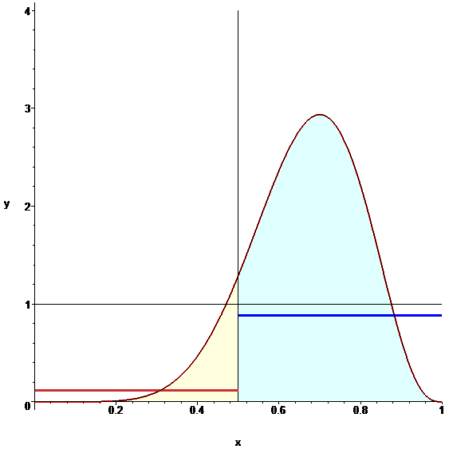
Bayesian Estimate of Labeler Quality
Quality=0.7 (unknown)
10 labels (7+, 3-)
Probability density
Observe assigned labels and estimate what is the noise level
Find the distribution of possible quality of labelers for the example
low ← quality of labelers → high

Slide 33
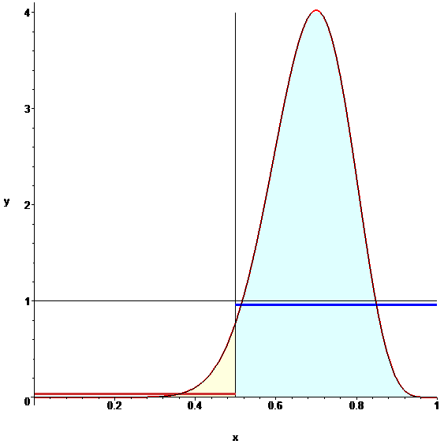
Label Uncertainty
Estimate the (distribution of) quality of the workers
For each quality level, estimate correct class
Integrate across all qualities
Label examples with Pr(class| votes) close to 0.5
Notes:
In computing our label uncertainty, we assumed that the majority of the mass of the estimated probability density over the labeler quality is on the correct side of the decision threshold. This might actually not be true with small numbers of labels OR in cases with high class skew (very common). Why in the latter case? Say p(-) >> p(+) and q is rather low. Then getting 2 or 3 + labels may be more likely due to labeler error than an indication that the correct class is probably +.

Slide 34
Another strategy: Model Uncertainty (MU)
Learning models of the data additional source of information about label certainty
Model uncertainty: get more labels for instances that cause model uncertainty in training data (i.e., irregularities!)
Examples
+ +
- - - -
Models
+ +
+ +
- - - -
- - - -
+ +
+ +
- - - -
- - - -
Self-healing process examines irregularities in training data
This is NOT active learning
+ +
+ +
- - - -
+
+ +
- - - -
+ +
- - - -
+ +
+ +
- - - -
- - - -
+ +
- - - -

Slide 35
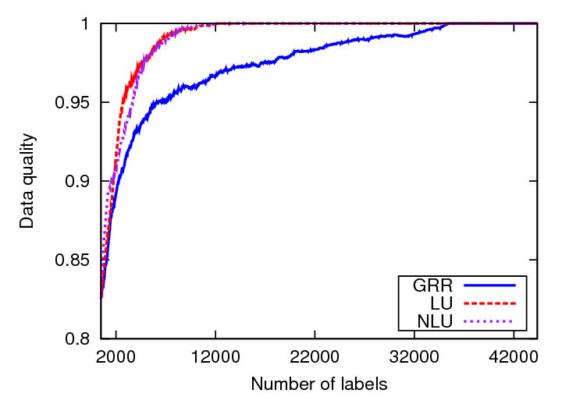
Adult content classification
Round robin
Selective

Slide 36
Improving worker participation
With just labeling, workers are passively labeling whatever we give them
Why not asking them to search themselves?

Slide 37
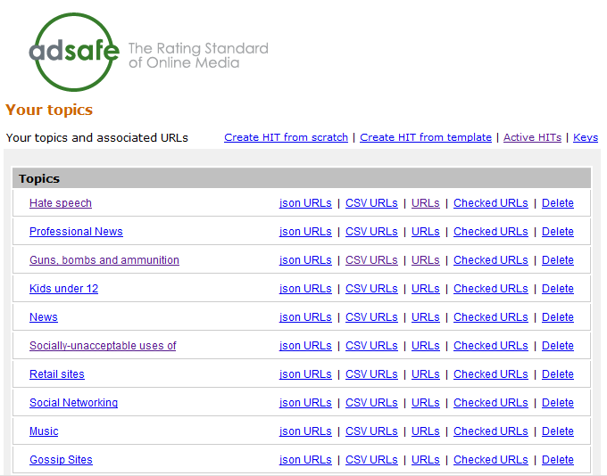
Guided Learning
Ask workers to find example web pages (great for “sparse” content)
After collecting enough examples, easy to build and test web page classifier
http://url-collector.appspot.com/allTopics.jsp

Slide 38
Limits of Guided Learning
No incentives for workers to find “new” content
After a while, submitted web pages similar to already submitted ones
No improvement for classifier
38
Notes:
pay for expert labeling?
alternative setting to active learning – where labeling is very costly
38

Slide 39
The result? Peaceful ignorance…
Classifier seems great: Cross-validation tests show excellent performance
Alas, classifier fails: The “unknown unknowns” ™
39
Notes:
39

Slide 40
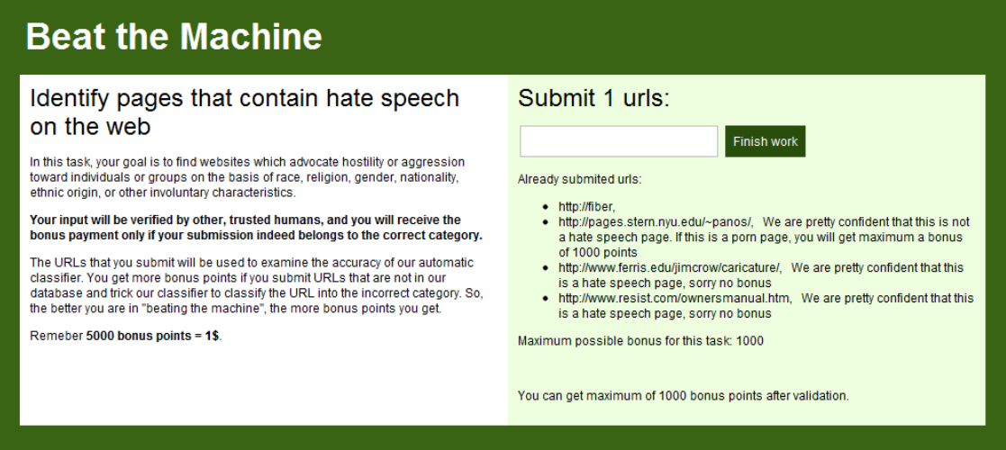
Beat the Machine!
Ask humans to find URLs that the classifier will miss
40
Example: Find hate speech pages that the machine will classify as benign
Notes:
40

Slide 41
Probes
Successes
Error rate for probes:
Hate: 16%, Drugs: 5%, Alcohol: 30%, Porn: 15%
Significantly higher than error rate of classifier on random data (10x to 100x)

Slide 42
Reward Structure
Once humans find the holes, they keep probing (e.g., multilingual porn ☺ )
After a while, we learn what we do not know (“unknown unknowns” → “known unknowns”)
Give higher reward for cases where:
Classifier confident (but wrong) and
We do not know it will be an error
42
Notes:
pay for expert labeling?
alternative setting to active learning – where labeling is very costly
42

Slide 43
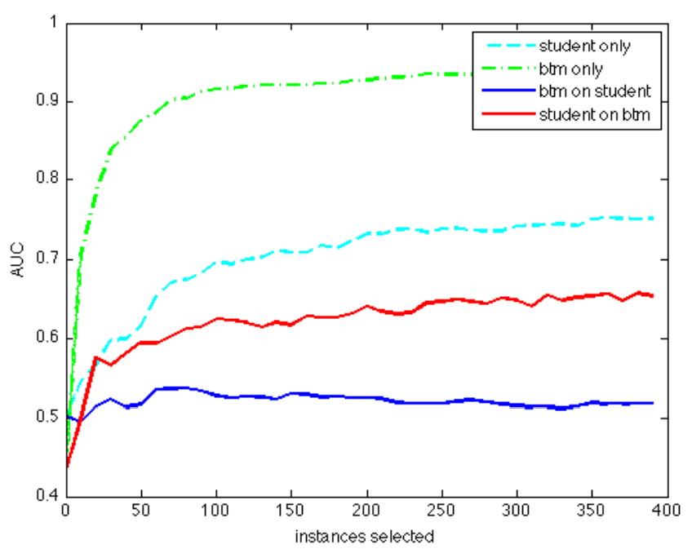
Structure of Successful Probes
Now, we identify errors much faster (and proactively)
Errors not random outliers: We can “learn” the errors, so there is a pattern there
Could not, so far, incorporate errors into existing classifier without degrading performance
43
Notes:
pay for expert labeling?
alternative setting to active learning – where labeling is very costly
43

Slide 44
Future Directions
Learn how to best incorporate knowledge to improve classifier
Measure prevalence of newly identified errors on the web (“query by document”)
Increase rewards for errors prevalent in the “generalized” case
44
Notes:
pay for expert labeling?
alternative setting to active learning – where labeling is very costly
44

Slide 45
Workers reacting to bad rewards/scores
Score-based feedback leads to strange interactions:
The “angry, has-been-burnt-too-many-times” worker:
“F*** YOU! I am doing everything correctly and you know it! Stop trying to reject me with your stupid ‘scores’!”
The overachiever worker:
“What am I doing wrong?? My score is 92% and I want to have 100%”

Slide 46
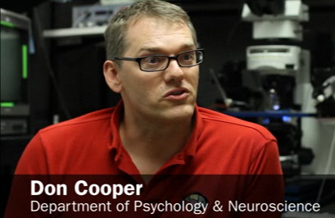
An unexpected connection at the NAS “Frontiers of Science” conf.
Your bad workers behave like my mice!

Slide 47
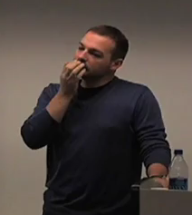
An unexpected connection at the NAS “Frontiers of Science” conf.
Your bad workers behave like my mice!
Eh?

Slide 48
An unexpected connection at the NAS “Frontiers of Science” conf.
Your bad workers want to engage their brain only for motor skills, not for cognitive skills
Yeah, makes sense…

Slide 49
An unexpected connection at the NAS “Frontiers of Science” conf.
And here is how I train my mice to behave…

Slide 50
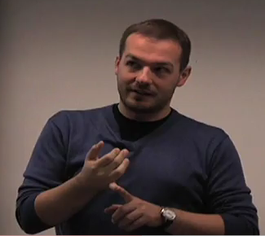
An unexpected connection at the NAS “Frontiers of Science” conf.
Confuse motor skills!
Reward cognition!
I should try this the moment that I get back to my room

Slide 51
Implicit Feedback using Frustration
Punish bad answers with frustration of motor skills (e.g., add delays between tasks)
“Loading image, please wait…”
“Image did not load, press here to reload”
“Network error. Return the HIT and accept again”
Reward good answers by rewarding the cognitive part of the brain (e.g, introduce variety/novelty, return results fast)
→Make this probabilistic to keep feedback implicit

Slide 52
First result
Spammer workers quickly abandon
Good workers keep labeling
Bad: Spammer bots unaffected
How to frustrate a bot?
Give it a CAPTHCA ☺

Slide 53
Second result (more impressive)
Remember, scheme was for training the mice…
15% of the spammers start submitting good work!
Putting cognitive effort is more beneficial …
Key trick: Learn to test workers on-the-fly

Slide 54
Thanks! Q & A?

Slide 55
Overflow Slides

Slide 56
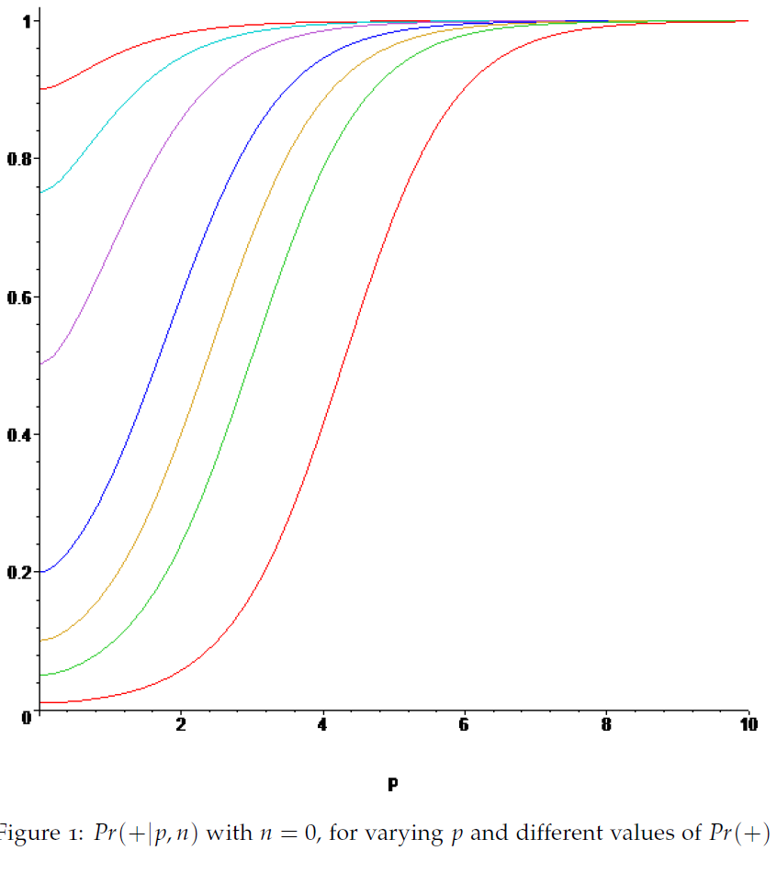

Slide 57
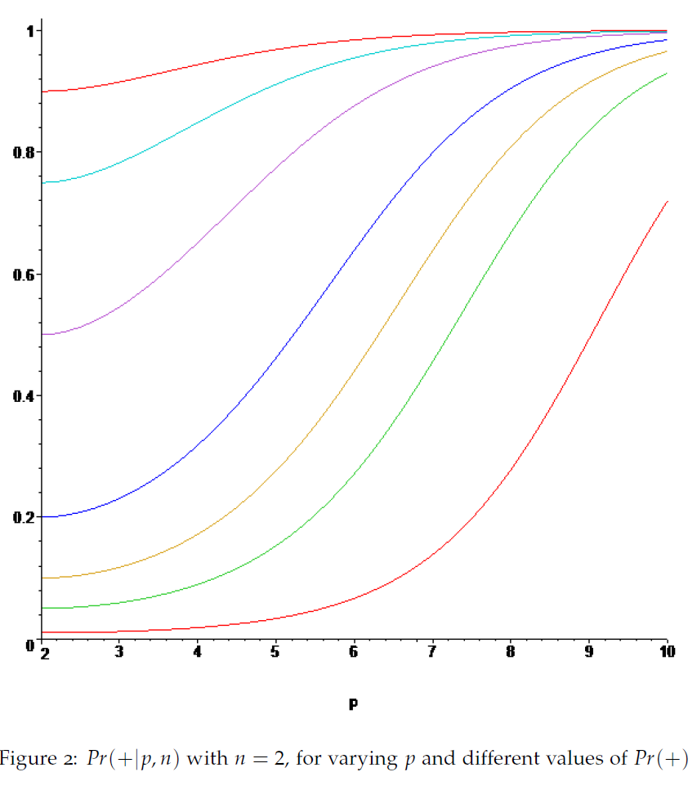

Slide 58
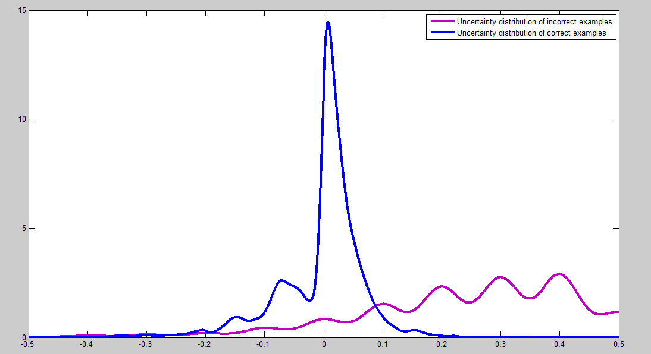
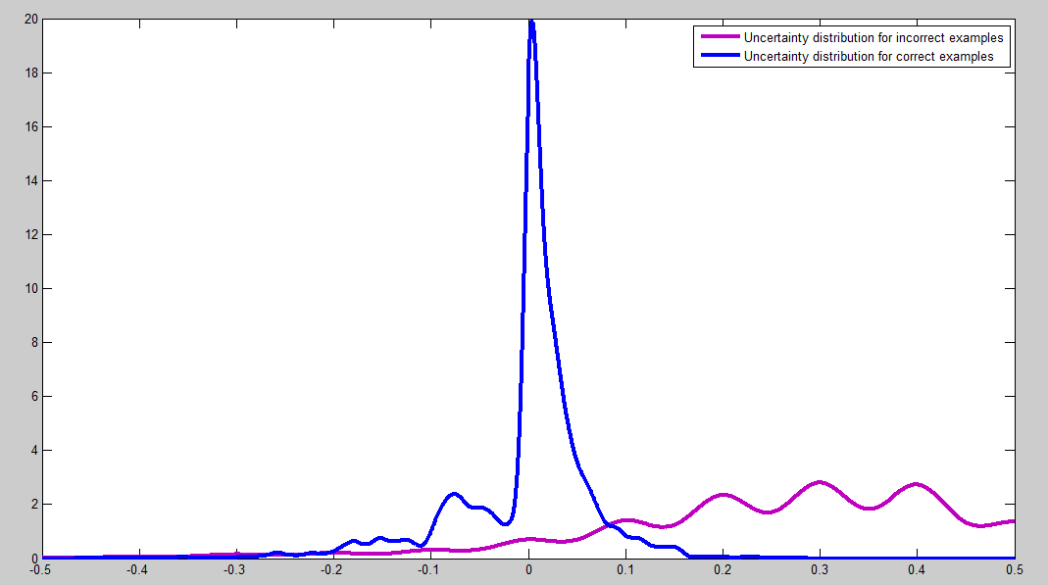
Why does Model Uncertainty (MU) work?
+ +
- - - -
+ +
+ +
- - - -
- - - -
- - - -
+ +
+ +
+
+ +
+ +
- - - -
- - - -
+ +
- - - -
+ +
- - - -
+ +
MU score distributions for correctly labeled (blue) and incorrectly labeled (purple) cases

Slide 59
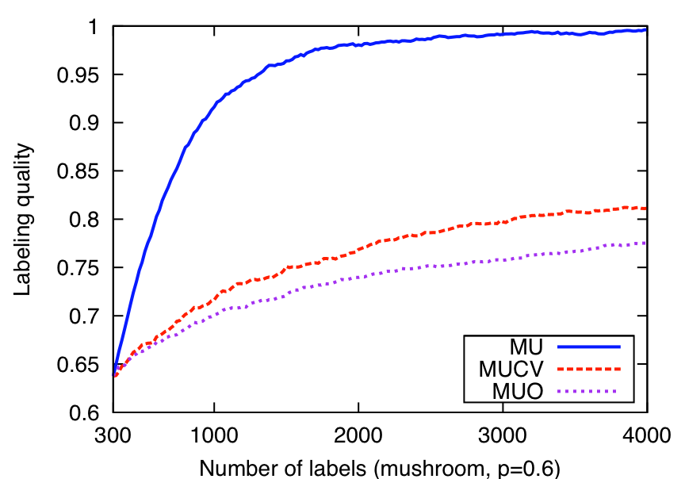
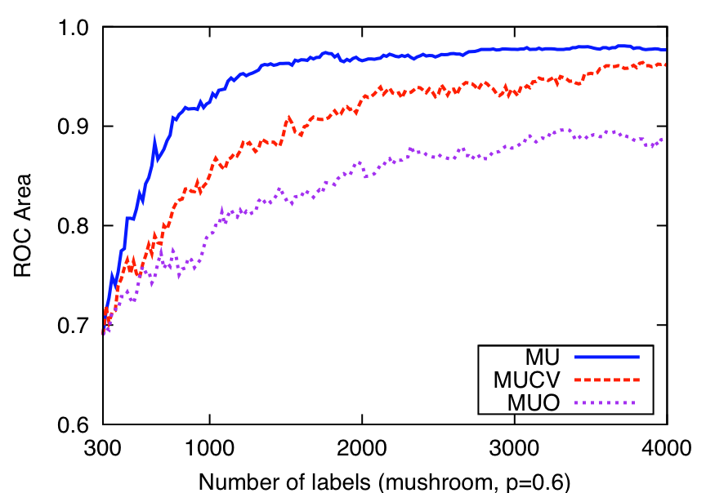
Why does Model Uncertainty (MU) work?
+ +
- - - -
+ +
+ +
- - - -
+ +
+ +
- - - -
- - - -
+
+ +
+ +
- - - -
- - - -
+ +
- - - -
+ +
- - - -
+ +
Self-healing process
Examples
Self-healing MU
Models
“active learning” MU

Slide 60
Soft Labeling vs. Majority Voting
MV: majority voting
ME: soft labeling

Slide 61
Related topic
Estimating (and using) the labeler quality
for multilabeled data: Dawid & Skene 1979; Raykar et al. JMLR 2010; Donmez et al. KDD09
for single-labeled data with variable-noise labelers: Donmez & Carbonell 2008; Dekel & Shamir 2009a,b
to eliminate/down-weight poor labelers: Dekel & Shamir, Donmez et al.; Raykar et al. (implicitly)
and correct labeler biases: Ipeirotis et al. HCOMP-10
Example-conditional labeler performance
Yan et al. 2010a,b
Using learned model to find bad labelers/labels: Brodley & Friedl 1999; Dekel & Shamir, Us (I’ll discuss)

Slide 62
More sophisticated LU improves labeling quality under class imbalance and fixes some pesky LU learning curve glitches
Both techniques
perform essentially optimally with balanced classes
Notes:
Other experiments show LU and NLU perform almost identically under balanced class distributions, and indeed are just about “optimal” –in the sense that they separate the positive and negative examples almost as well as knowing the actual uncertainty (the best uncertainty metric possible when we are only taking into account the information in the label multiset).

Slide 63
Yet another strategy: Label & Model Uncertainty (LMU)
Label and model uncertainty (LMU): avoid examples where either strategy is certain

Slide 64
Another strategy: Model Uncertainty (MU)
+ +
- - - -
+ +
+ +
- - - -
+ +
- - - -
- - - -
+ +
+
+ +
+ +
- - - -
- - - -
+ +
- - - -
+ +
- - - -
+ +
Learning models of the data provides an alternative source of information about label certainty
Model uncertainty: get more labels for instances that cause model uncertainty
Intuition?
for modeling: why improve training data quality if model already is certain there?
for data quality, low-certainty “regions” may be due to incorrect labeling of corresponding instances
Examples
Models
Self-healing process
KDD 2008

Slide 65
Label Quality
Label + Model Uncertainty
Label Uncertainty
Model Uncertainty alone also improves quality
1
0.95
0.9
0.85
0.8
Labeling quality
Uniform, round robin
0.75
0.7
UNF
MU
0.65
LU
LMU
0.6
0
400
800
1200
1600
2000
Number of labels (waveform, p=0.6)

Slide 66
Model Quality
Across 12 domains, LMU is always better
than GRR. LMU is statistically significantly
better than LU and MU.
Label & Model Uncertainty
66
Notes:
66

Slide 67
What about Gold testing?
Naturally integrated into the latent class model
Initialize by aggregating labels for each object (e.g., use majority vote)
Estimate error rates for workers (using aggregate labels)
Estimate aggregate labels (using error rates, weight worker votes according to quality)
Keep labels for “gold data” unchanged
Go to Step 2 and iterate until convergence

Slide 68
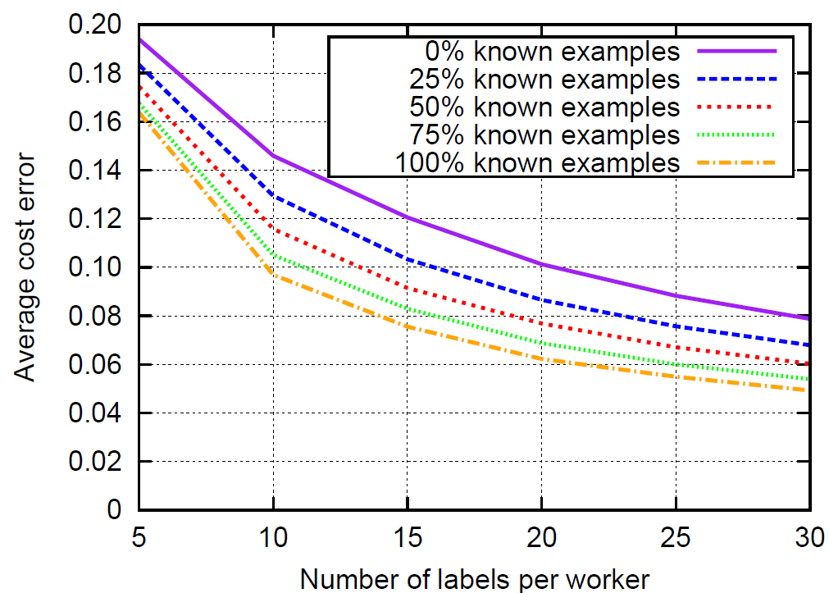
Gold Testing?
3 labels per example
2 categories, 50/50
Quality range: 0.55:0.05:1.0
200 labelers

Slide 69
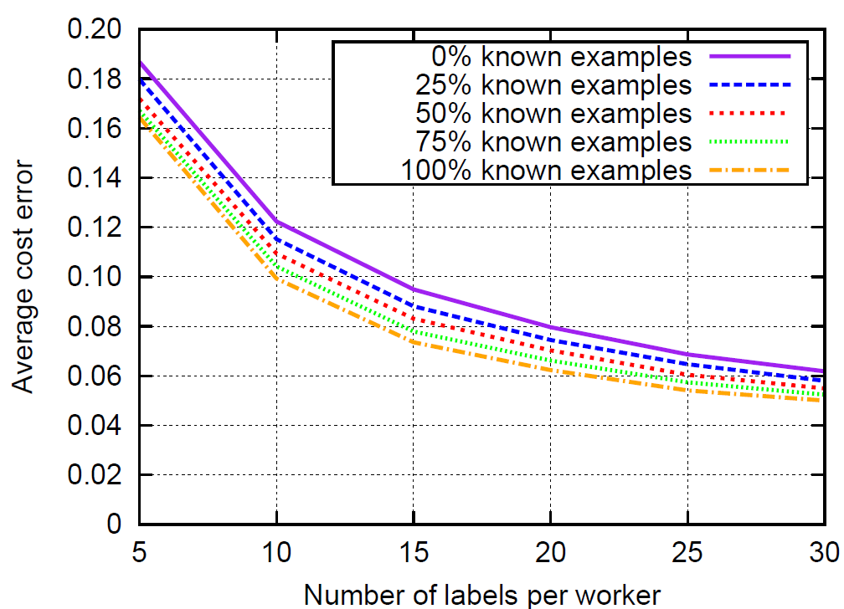
Gold Testing?
5 labels per example
2 categories, 50/50
Quality range: 0.55:0.05:1.0
200 labelers

Slide 70
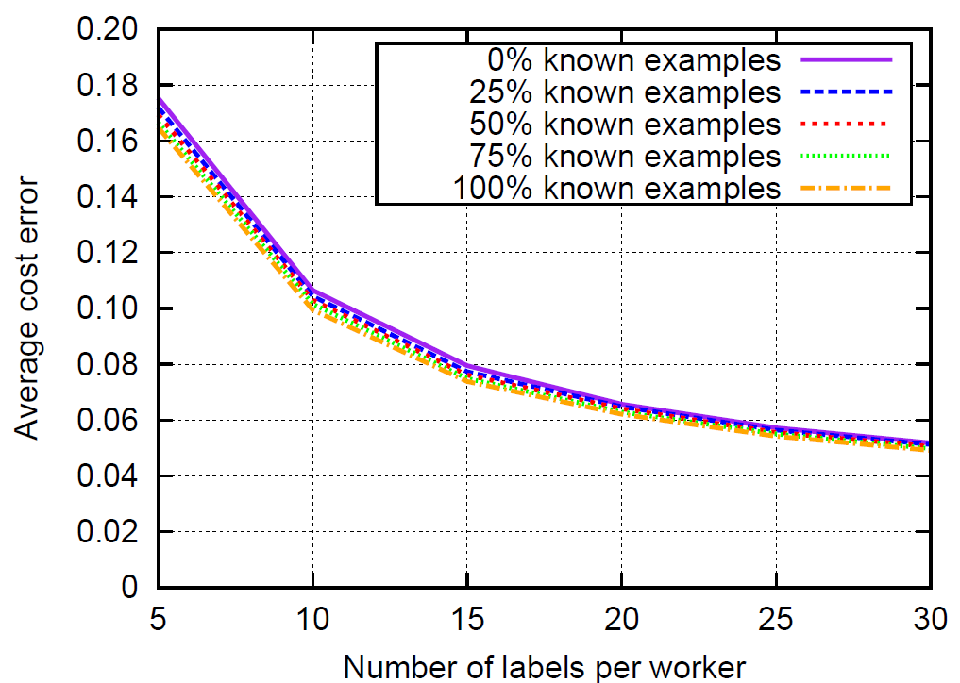
Gold Testing?
10 labels per example
2 categories, 50/50
Quality range: 0.55:0.05:1.0
200 labelers

Slide 71
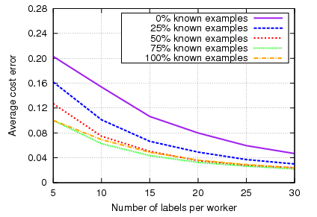
Gold Testing
10 labels per example
2 categories, 90/10
Quality range: 0.55:0.1.0
200 labelers
Advantage under imbalanced datasets

Slide 72
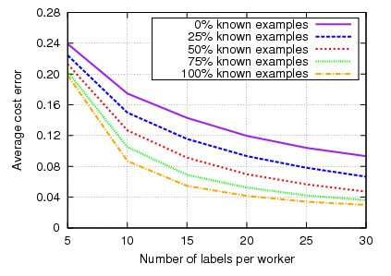
Gold Testing
5 labels per example
2 categories, 50/50
Quality range: 0.55:0.65
200 labelers
Advantage with bad worker quality

Slide 73
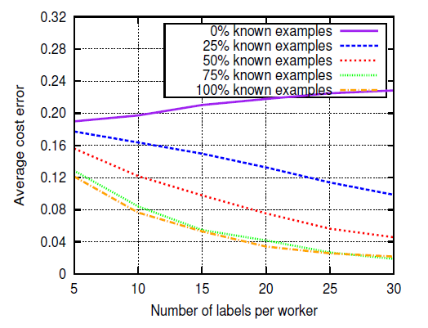
Gold Testing?
10 labels per example
2 categories, 90/10
Quality range: 0.55:0.65
200 labelers
Significant advantage under “bad conditions” (imbalanced datasets, bad worker quality)

