Slide 1
The need for standardization
Panos Ipeirotis, New York University
John Horton, oDesk

Slide 2
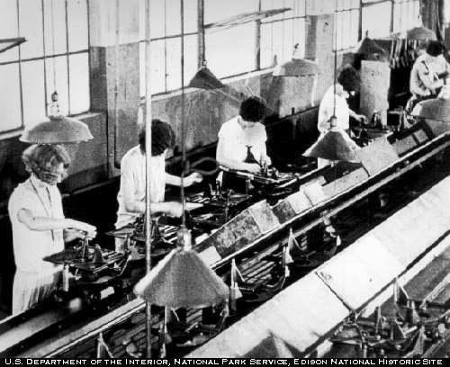
Crowdsourcing: The dream
The assembly line for knowledge work

Slide 3
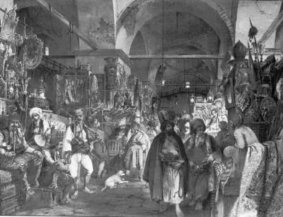
Crowdsourcing: The reality
The bazaar of knowledge work

Slide 4
The transcription bazaar
Price discovery impossible
A variety of interfaces make specialization difficult

Slide 5
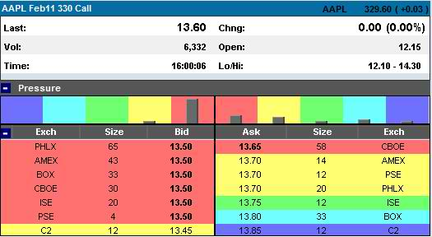
Standardize and Price like Stock market
With standardized work units:
  Easier to enter for requesters
  Easier to train workers
  Easier to build composite workflows
  Automatic pricing with bid/ask
  Pricing controls speed
  in a predictable manner

