Slide 1
Get Another Label?
Improving Data Quality and Data Mining
Using Multiple, Noisy Labelers
Panos Ipeirotis
Stern School of Business
New York University
Joint work with Victor Sheng, Foster Provost, and Jing Wang

Slide 2
Motivation
Many task rely on high-quality labels for objects:
  relevance judgments for search engine results
  identification of duplicate database records
  image recognition
  song categorization
  videos
Labeling can be relatively inexpensive, using Mechanical Turk, ESP game …

Slide 3

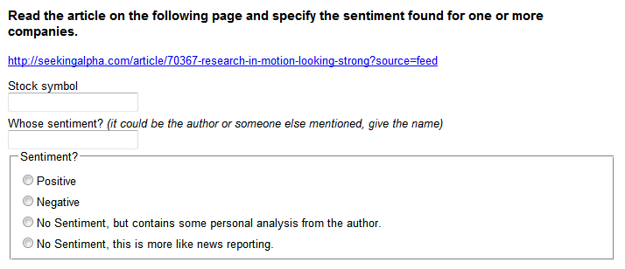
Micro-Outsourcing: Mechanical Turk
Requesters post micro-tasks, a few cents each

Slide 4
Motivation
Labels can be used in training predictive models
But: labels obtained through such sources are
noisy.
This directly affects the quality of learning models

Slide 5
Quality and Classification Performance
Labeling quality increases  classification quality increases
Q = 1.0
Q = 0.8
Q = 0.6
Q = 0.5
Training set size

Slide 6
How to Improve Labeling Quality
Find better labelers
  Often expensive, or beyond our control
Use multiple noisy labelers: repeated-labeling
  Our focus

Slide 7
Majority Voting and Label Quality
Ask multiple labelers, keep majority label as “true” label
Quality is probability of majority label being correct
P=1.0
P=0.9
P=0.8
P is probability
of individual labeler
being correct
P=0.7
P=0.6
P=0.5
P=0.4

Slide 8
Tradeoffs for Modeling
Get more examples  Improve classification
Get more labels per example  Improve quality  Improve classification
Q = 1.0
Q = 0.8
Q = 0.6
Q = 0.5

Slide 9
Basic Labeling Strategies
Single Labeling
  Get as many data points as possible
  One label each
Round-robin Repeated Labeling
  Repeatedly label data points,
  Give next label to the one with the fewest so far

Slide 10
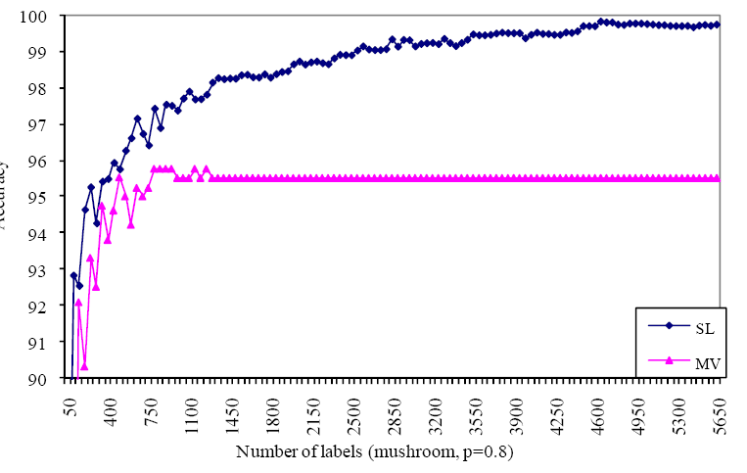
Repeat-Labeling vs. Single Labeling
Single
Repeated
P= 0.8, labeling quality
K=5, #labels/example
With low noise, more (single labeled) examples better

Slide 11
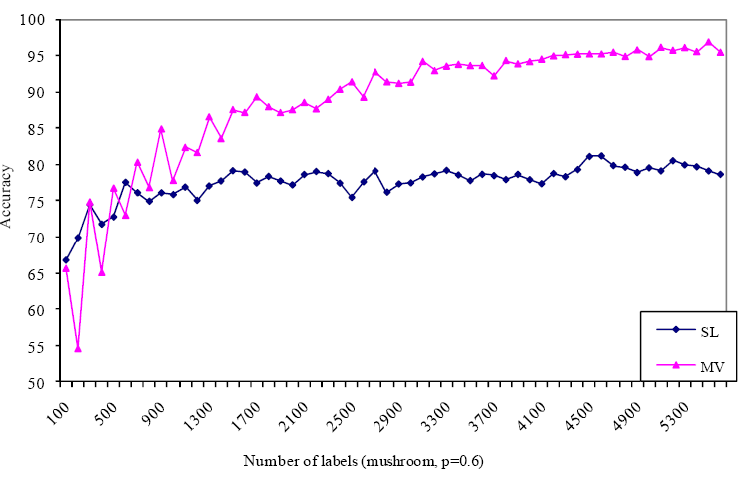
Repeat-Labeling vs. Single Labeling
Repeated
Single
P= 0.6, labeling quality
K=5, #labels/example
With high noise, repeated labeling better

Slide 12
Selective Repeated-Labeling
We have seen:
  With enough examples and noisy labels, getting multiple labels is better than single-labeling
Can we do better than the basic strategies?
Key observation: we have additional information to guide selection of data for repeated labeling
  the current multiset of labels
Example: {+,-,+,+,-,+} vs. {+,+,+,+}
Notes:
if we’re getting a certain number of labels, how best to choose?

Slide 13
Natural Candidate: Entropy
Entropy is a natural measure of label uncertainty:
E({+,+,+,+,+,+})=0
E({+,-, +,-, +,- })=1
Strategy: Get more labels for high-entropy label multisets

Slide 14
What Not to Do: Use Entropy
Improves at first,
hurts in long run

Slide 15
Why not Entropy
In the presence of noise, entropy will be high even with many labels
Entropy is scale invariant
  (3+ , 2-) has same entropy as (600+ , 400-)

Slide 16
Estimating Label Uncertainty (LU)
Observe +’s and –’s and compute Pr{+|obs} and Pr{-|obs}
Label uncertainty = tail of beta distribution
Beta probability density function
S_{LU}
0.0
0.5
1.0

Slide 17
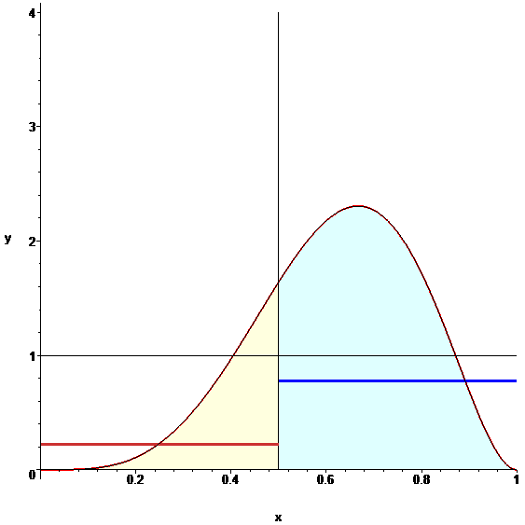
Label Uncertainty
p=0.7
5 labels
(3+, 2-)
Entropy ~ 0.97
CDF_{β}=0.34

Slide 18
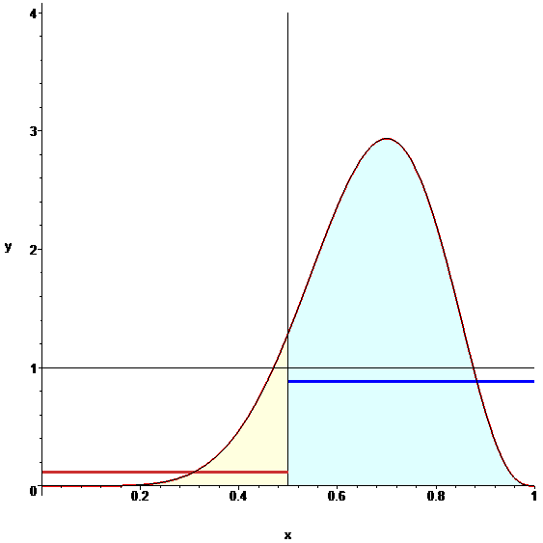
Label Uncertainty
p=0.7
10 labels
(7+, 3-)
Entropy ~ 0.88
CDF_{β}=0.11

Slide 19
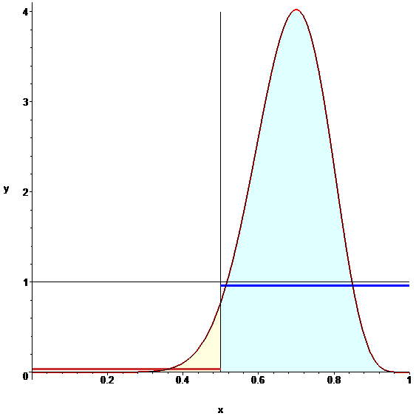
Label Uncertainty
p=0.7
20 labels
(14+, 6-)
Entropy ~ 0.88
CDF_{β}=0.04

Slide 20
Quality Comparison
Label Uncertainty
Round robin
(already better than single labeling)

Slide 21
Model Uncertainty (MU)
+ +
- - - -
+ +
?
+ +
- - - -
+ +
+ +
- - - -
- - - -
+ +
+ +
- - - -
- - - -
+ +
- - - -
+ +
- - - -
+ +
?
?
Learning a model of the data provides an alternative source of information about label certainty
Model uncertainty: get more labels for instances that cause model uncertainty
Intuition?
  for data quality, low-certainty “regions” may be due to incorrect labeling of corresponding instances
  for modeling: why improve training data quality if model already is certain there?
Examples
Models
Self-healing process

Slide 22
Label + Model Uncertainty
Label and model uncertainty (LMU): avoid examples where either strategy is certain

Slide 23
Quality
Model Uncertainty alone also improves quality
Label + Model Uncertainty
Label Uncertainty
Uniform, round robin

Slide 24
Comparison: Model Quality (I)
Across 12 domains, LMU is always better
than GRR. LMU is statistically significantly
better than LU and MU.
Label & Model Uncertainty
24
Notes:
24

Slide 25
Comparison: Model Quality (II)
Across 12 domains, LMU is always better
than GRR. LMU is statistically significantly
better than LU and MU.

Slide 26
Summary of results
Micro-outsourcing (e.g., MTurk, RentaCoder, ESP game) change the landscape for data acquisition
Repeated labeling improves data quality and model quality
With noisy labels, repeated labeling can be preferable to single labeling
When labels relatively cheap, repeated labeling can do much better than single labeling
Round-robin repeated labeling works well
Selective repeated labeling improves substantially

Slide 27
Opens up many new directions…
Strategies using “learning-curve gradient”
Estimating the quality of each labeler
Example-conditional labeling difficulty
Increased compensation vs. labeler quality
Multiple “real” labels
Truly “soft” labels
Selective repeated tagging

Slide 28
Other Projects
SQoUT project
Structured Querying over Unstructured Text
http://sqout.stern.nyu.edu
Faceted Interfaces
EconoMining project
The Economic Value of User Generated Content
http://economining.stern.nyu.edu

Slide 29
SQoUT: Structured Querying over Unstructured Text
Information extraction applications extract structured relations from unstructured text
July 8, 2008: Intel Corporation and DreamWorks Animation
today announced they have formed a strategic alliance
aimed at revolutionizing 3-D filmmaking technology,…
Alliances covered in The New York Times
Date | Company1 | Company2
08/06/08 | BP | Veneriu
04/30/07 | Omniture | Vignette
06/18/06 | Microsoft | Nortel
07/08/08 | Intel Corp. | DreamWorks
Information
Extraction System
(e.g., OpenCalais)
Alliances and strategic partnerships before 1990 are sparsely covered in databases such as SDC Platinum

Slide 30
In an ideal world…
SIGMOD’06, TODS’07,
ICDE’09, TODS’09
Output Tokens
…
Text Databases
Extraction
System(s)
Retrieve documents from database/web/archive
Process documents
Extract output tuples
SELECT Date, Company1, Company2
FROM Alliances
USING OpenCalais
OVER NYT_archive
[WITH recall>0.2 AND precision >0.9]

Slide 31
SQoUT: The Questions
SIGMOD’06 best paper,
TODS’07, ICDE’09,TODS’09
Output Tokens
…
Text Databases
Extraction
System(s)
Retrieve documents from database/web/archive
Process documents
Extract output tuples
Questions:
How to we retrieve the documents?
(Scan all? Specific websites? Query Google?)
How to configure the extraction systems?
What is the execution time?
What is the output quality?

Slide 32

EconoMining Project
Show me the Money!
Basic Idea
Opinion mining an important application of information extraction
Opinions of users are reflected in some economic variable (price, sales)
Applications (in increasing order of difficulty)
Buyer feedback and seller pricing power in online marketplaces (ACL 2007)
Product reviews and product sales (KDD 2007)
Importance of reviewers based on economic impact (ICEC 2007)
Hotel ranking based on “bang for the buck” (WebDB 2008)
Political news (MSM, blogs), prediction markets, and news importance

Slide 33
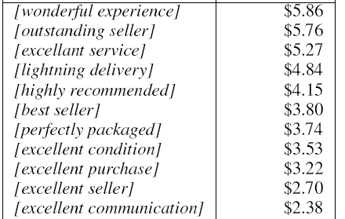
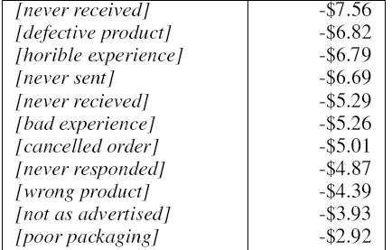
Some Indicative Dollar Values
Positive
Negative
captures misspellings as well
Natural method for extracting sentiment strength and polarity
good packaging
-$0.56
Positive?
Negative
?
Naturally captures the pragmatic meaning within the given context

Slide 34
Thanks!
Q & A?

Slide 35
Estimating Labeler Quality
(Dawid, Skene 1979): “Multiple diagnoses”
  Assume equal qualities
  Estimate “true” labels for examples
  Estimate qualities of labelers given the “true” labels
  Repeat until convergence

Slide 36
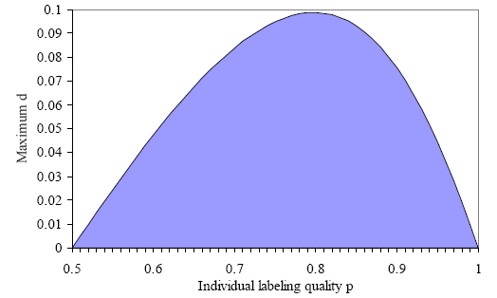
So…
Multiple noisy labelers improve quality
(Sometimes) quality of multiple noisy labelers better than quality of best labeler in set
So, should we always get multiple labels?

Slide 37
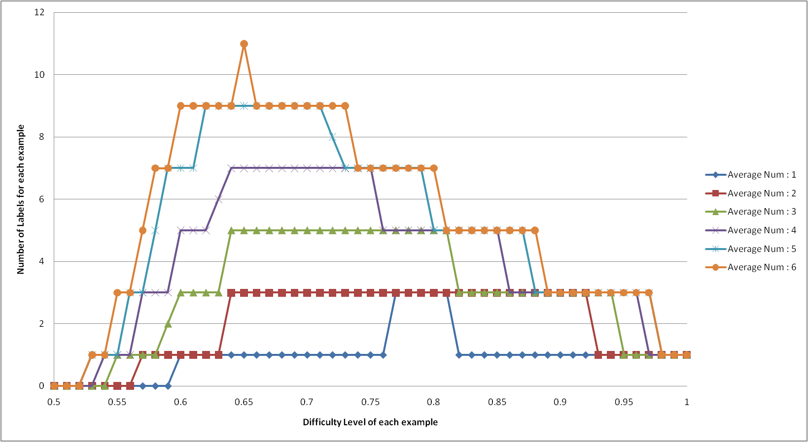
Optimal Label Allocation

